Slide 1
Current Labor
Market Trends:
Lancaster County
Commissioned By:
Lancaster County Workforce
Development Board
Published:
May 2023
Equal Opportunity Program/Employer.
Auxiliary aids and services available upon
request to those with disabilities.
Program funded with federal dollars.
For detailed information, see https://www.lancastercountywib.com/organizational-integrity/operating-documents

Slide 2
Key Takeaways
Lancaster County’s labor force has recovered from the pandemic, rebounding back to 2019 levels.
Employers in key sectors face strong wage growth yet neutral employment growth.
A regional comparison highlights higher wages in York and Berks Counties than in Lancaster County in key sectors.
The purpose of this analysis is to understand the shock and impact of the pandemic on Lancaster County’s labor market utilizing key data points from 2019 – 2022.

Slide 3
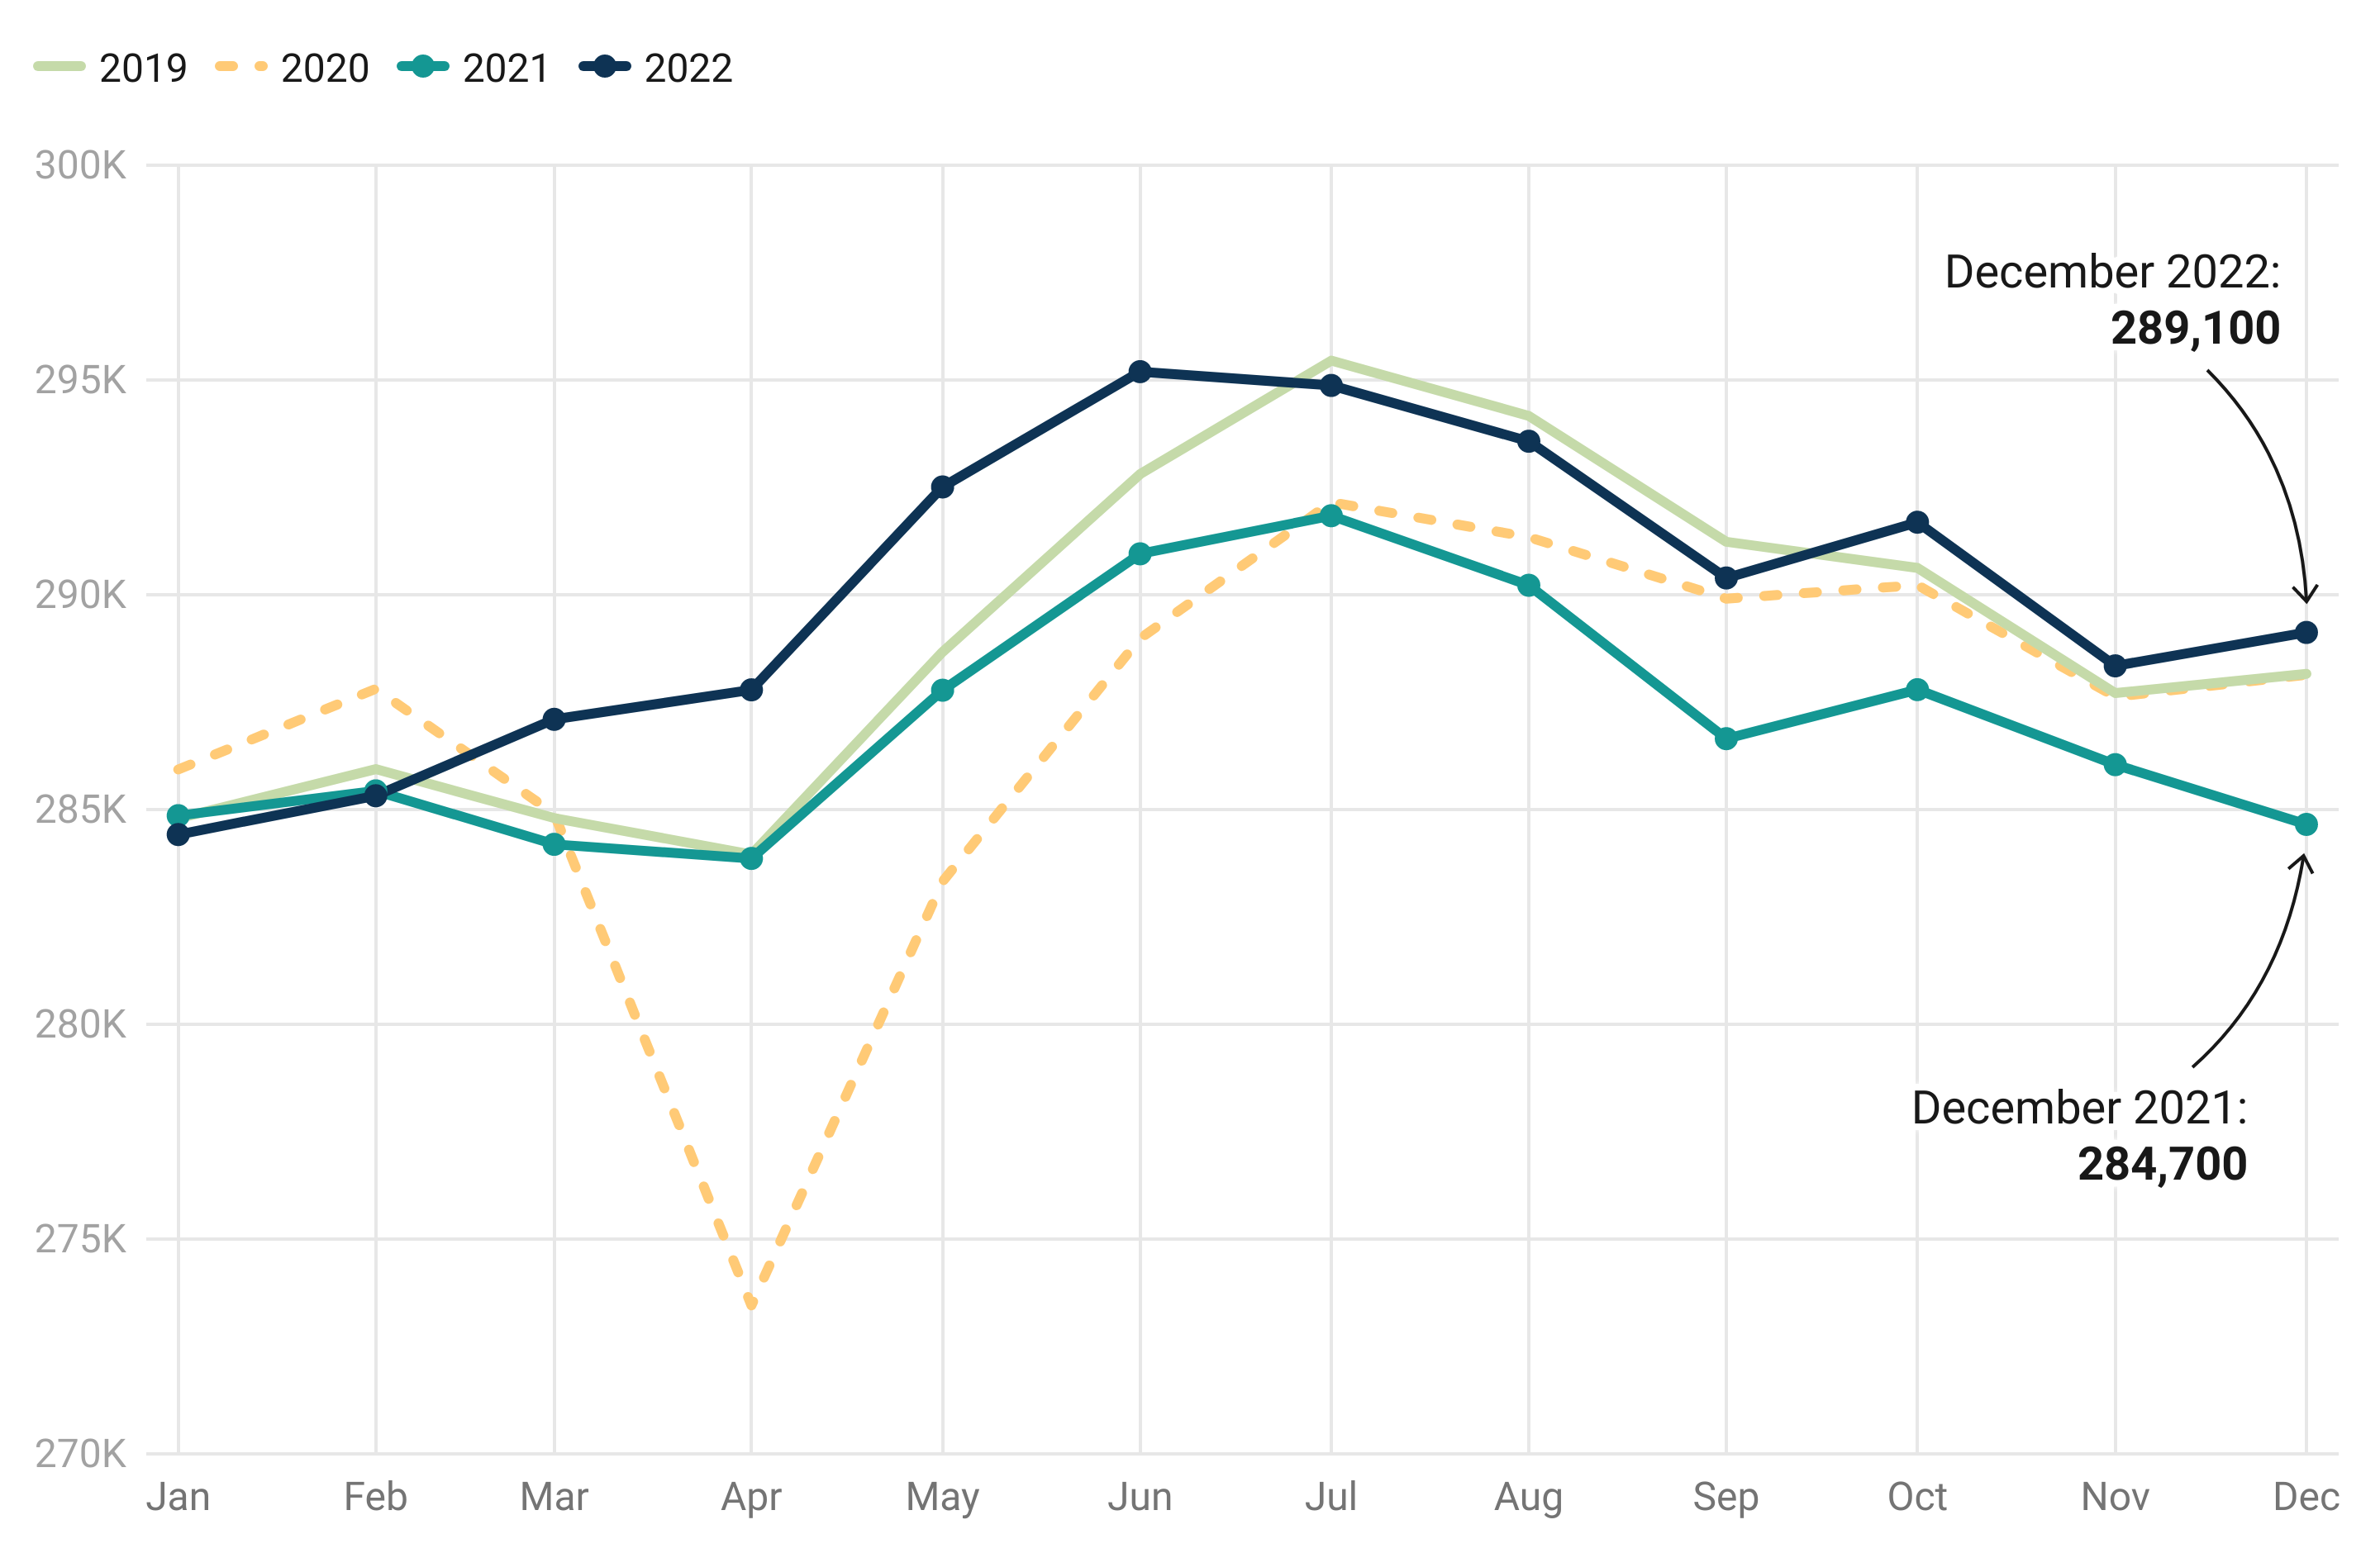
Labor Supply in Lancaster County (2019-2022)
Average of 1% or 3,000 more workers in 2022 than in 2021
Average of 0.3% or 1,000 more workers in 2022 than in 2019
Return to seasonal labor trends
US Bureau of Labor Statistics, “Local Area Unemployment Statistics (LAUS)”; bls.gov/lau
Notes:
Revised data corrects an incorrect narrative… thought we were behind …. Now we know that we have been higher in 2022. Revised data is more on par with our business conversations… highlights the importance of data and field interviews looked at together.

Slide 4
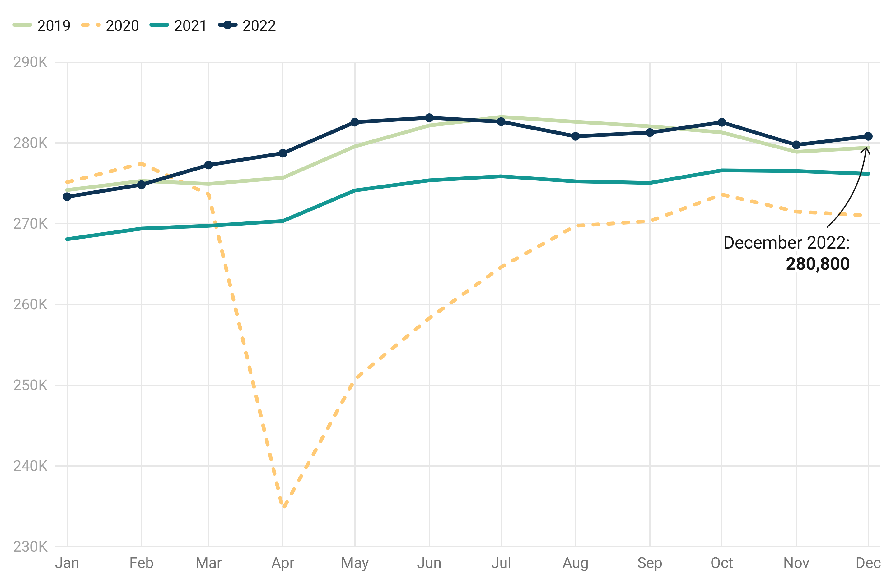
Employment in Lancaster County (2019-2022)
Lancaster County had an average of 2.3% or 6,300 more people employed in 2022 than in 2021.
Per capita economic output (based on $ of GDP) in 2021 was greater than 2019.
US Bureau of Labor Statistics, “Local Area Unemployment Statistics (LAUS)”; bls.gov/lau
Notes:
Anecdotally and broadly businesses reported feeling ‘better’ about workforce challenges in 2022 – more applicants for open positions, fewer shortages. Still, there is strain in the workforce given economic output remains strong. GDP in 2018 $27BB; in 2019 is $27.1BB; 2020 = $25.9BB; 2021 = $27.1B. 2022 GDP #s for lanc lag and will not be known for some time, but assuming they continue to grow, it means the output is being done on the backs of fewer people.

Slide 5
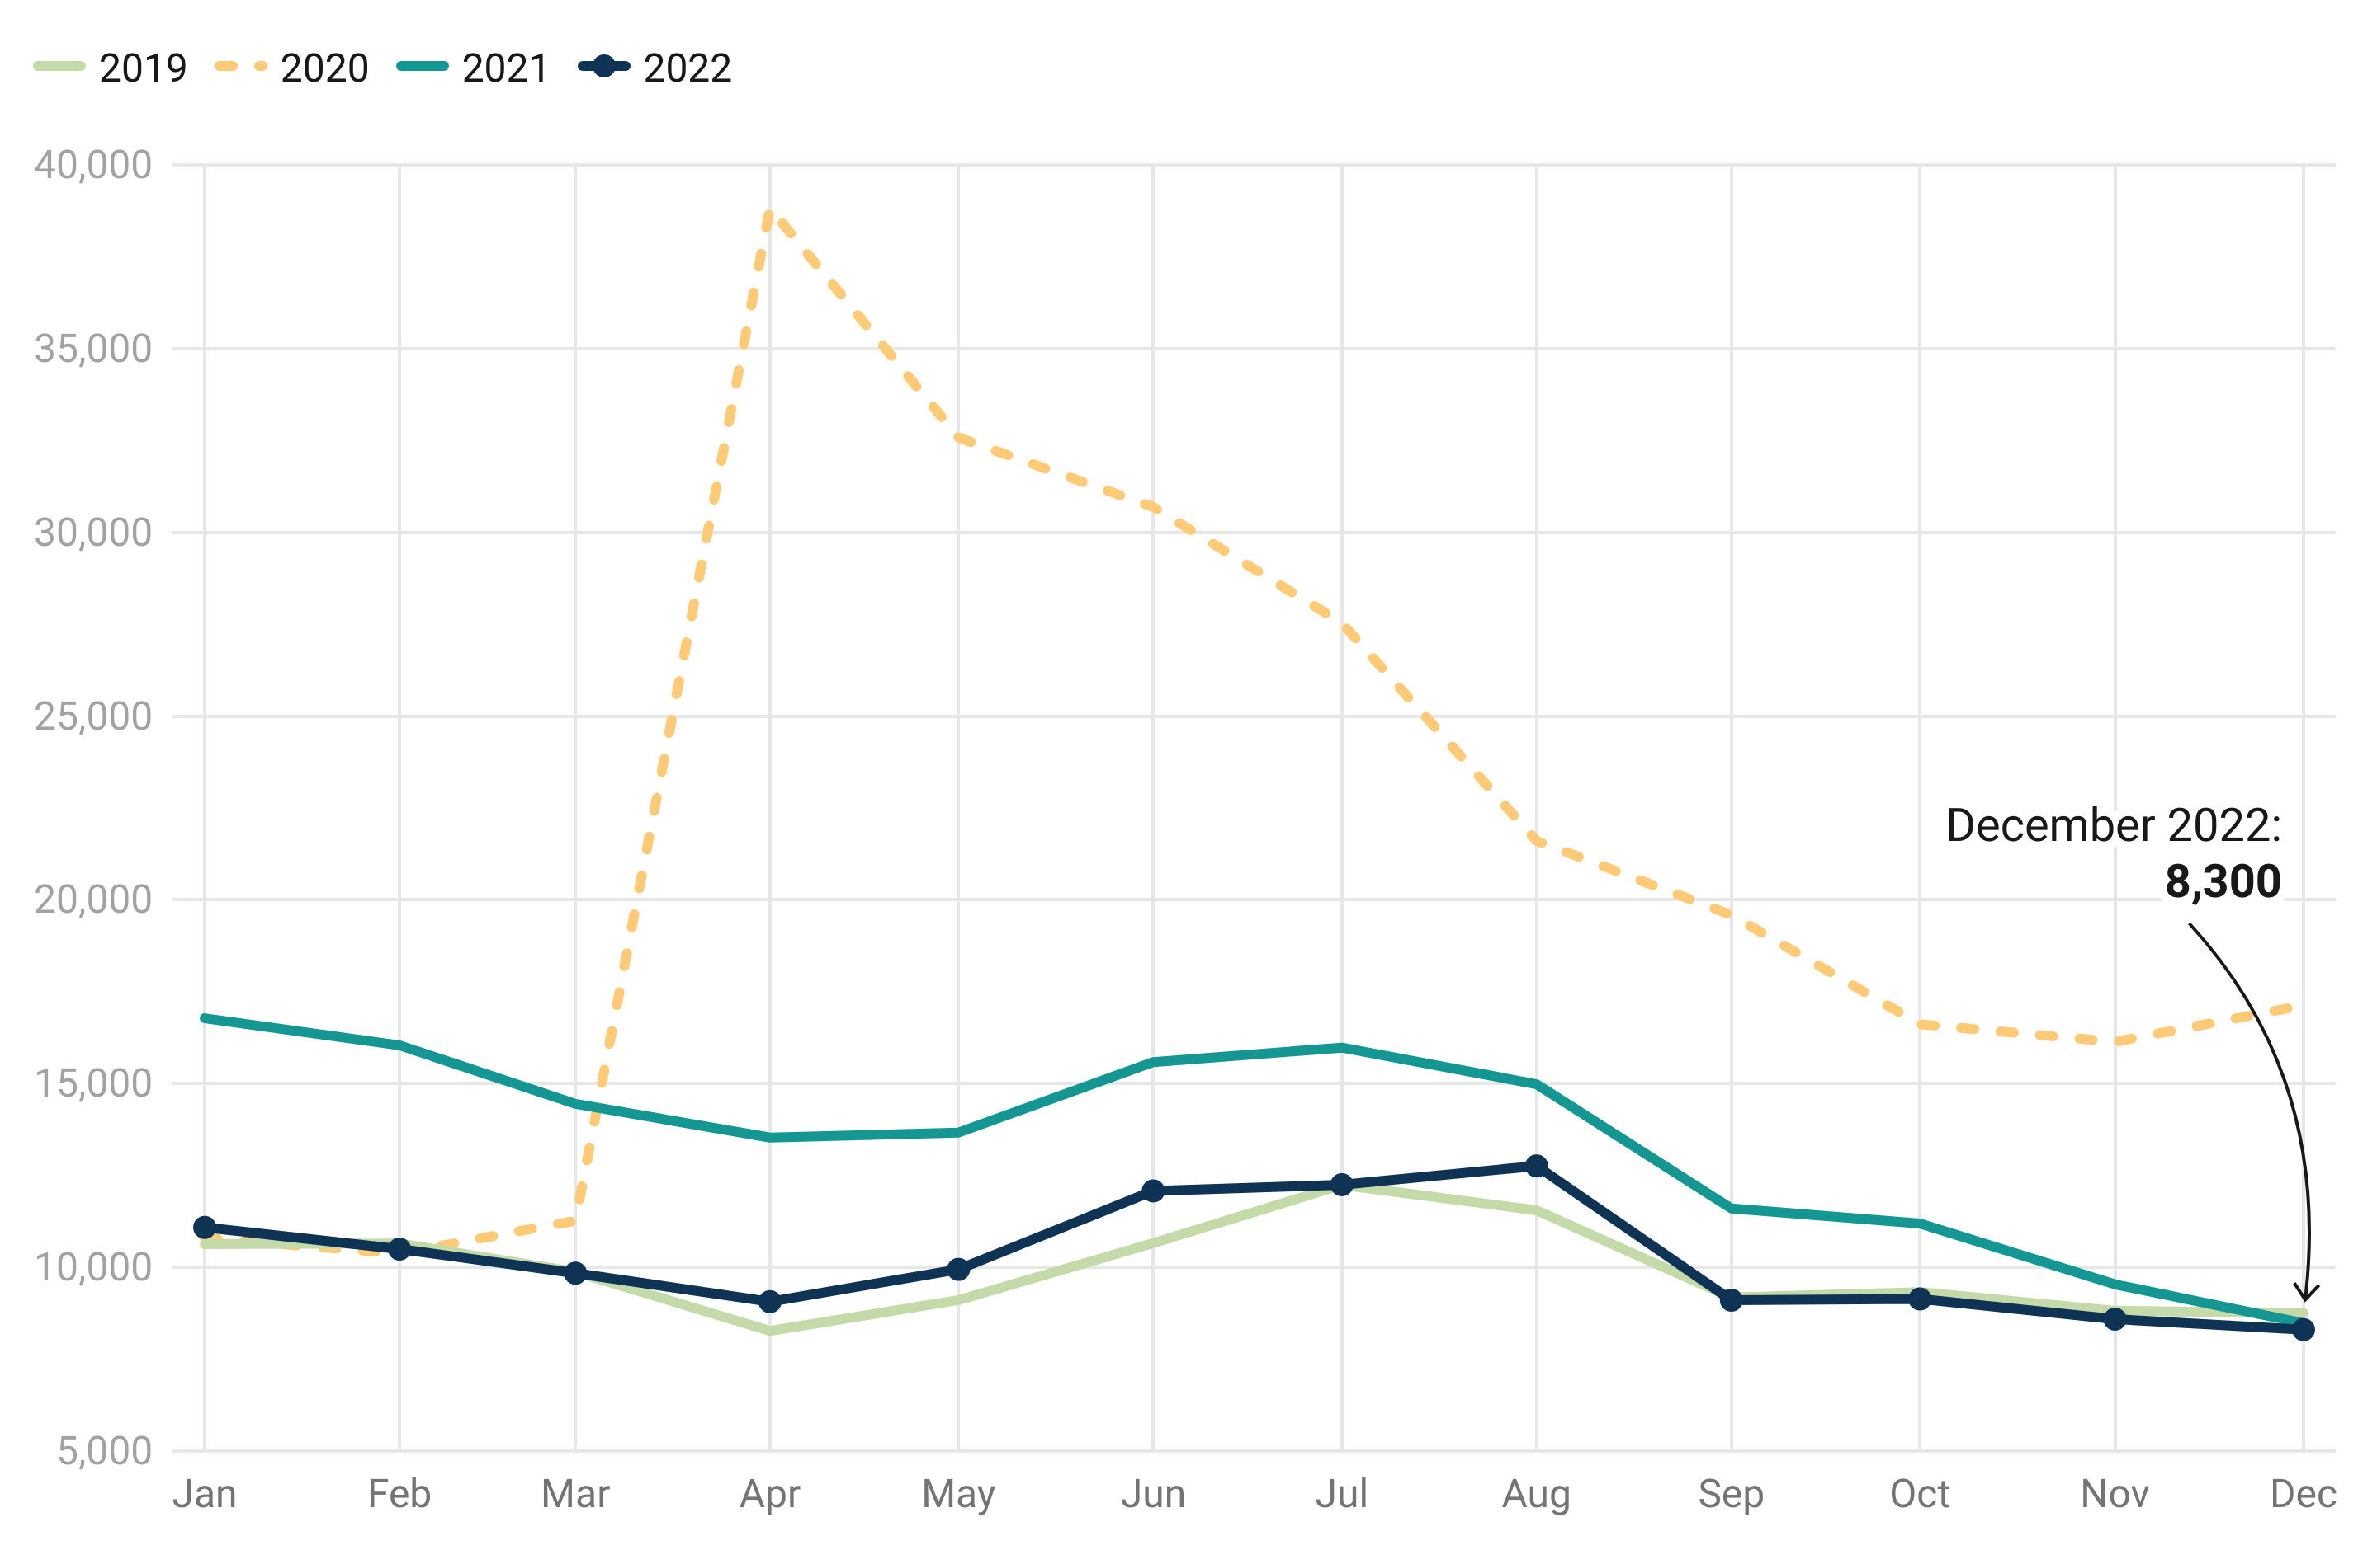
Unemployment in Lancaster County (2019-2022)
The unemployment rate reached a low of 2.9% in December of 2022 (0.6% above the lowest recorded unemployment rate since 1990).
The unemployment rate in 2022 was relatively consistent with the unemployment rate in 2019.
US Bureau of Labor Statistics, “Local Area Unemployment Statistics (LAUS)”; bls.gov/lau

Slide 6
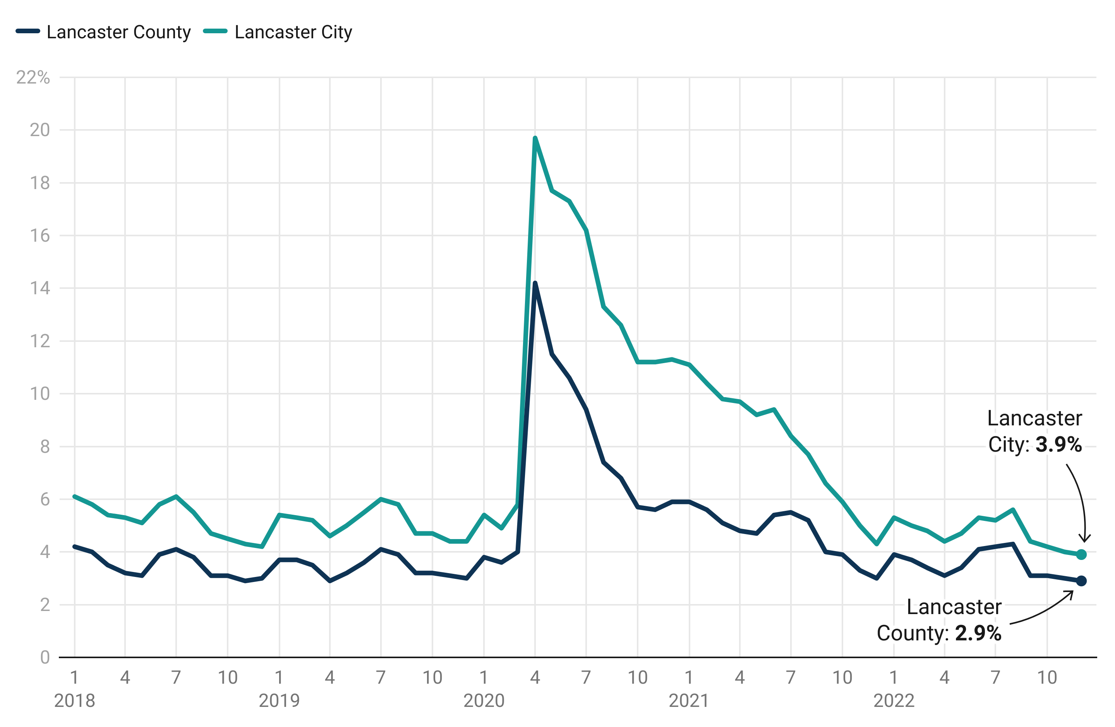
Unemployment Rate: Lancaster County vs Lancaster City (2018-2022)
The average difference between the unemployment rate in Lancaster County and Lancaster City was smaller in 2022 than in 2019:
  2019: 1.7%
  2022: 1.2%
US Bureau of Labor Statistics, “Local Area Unemployment Statistics (LAUS)”; bls.gov/lau
Notes:
Helps all communities… tighten up the city to county.

Slide 7
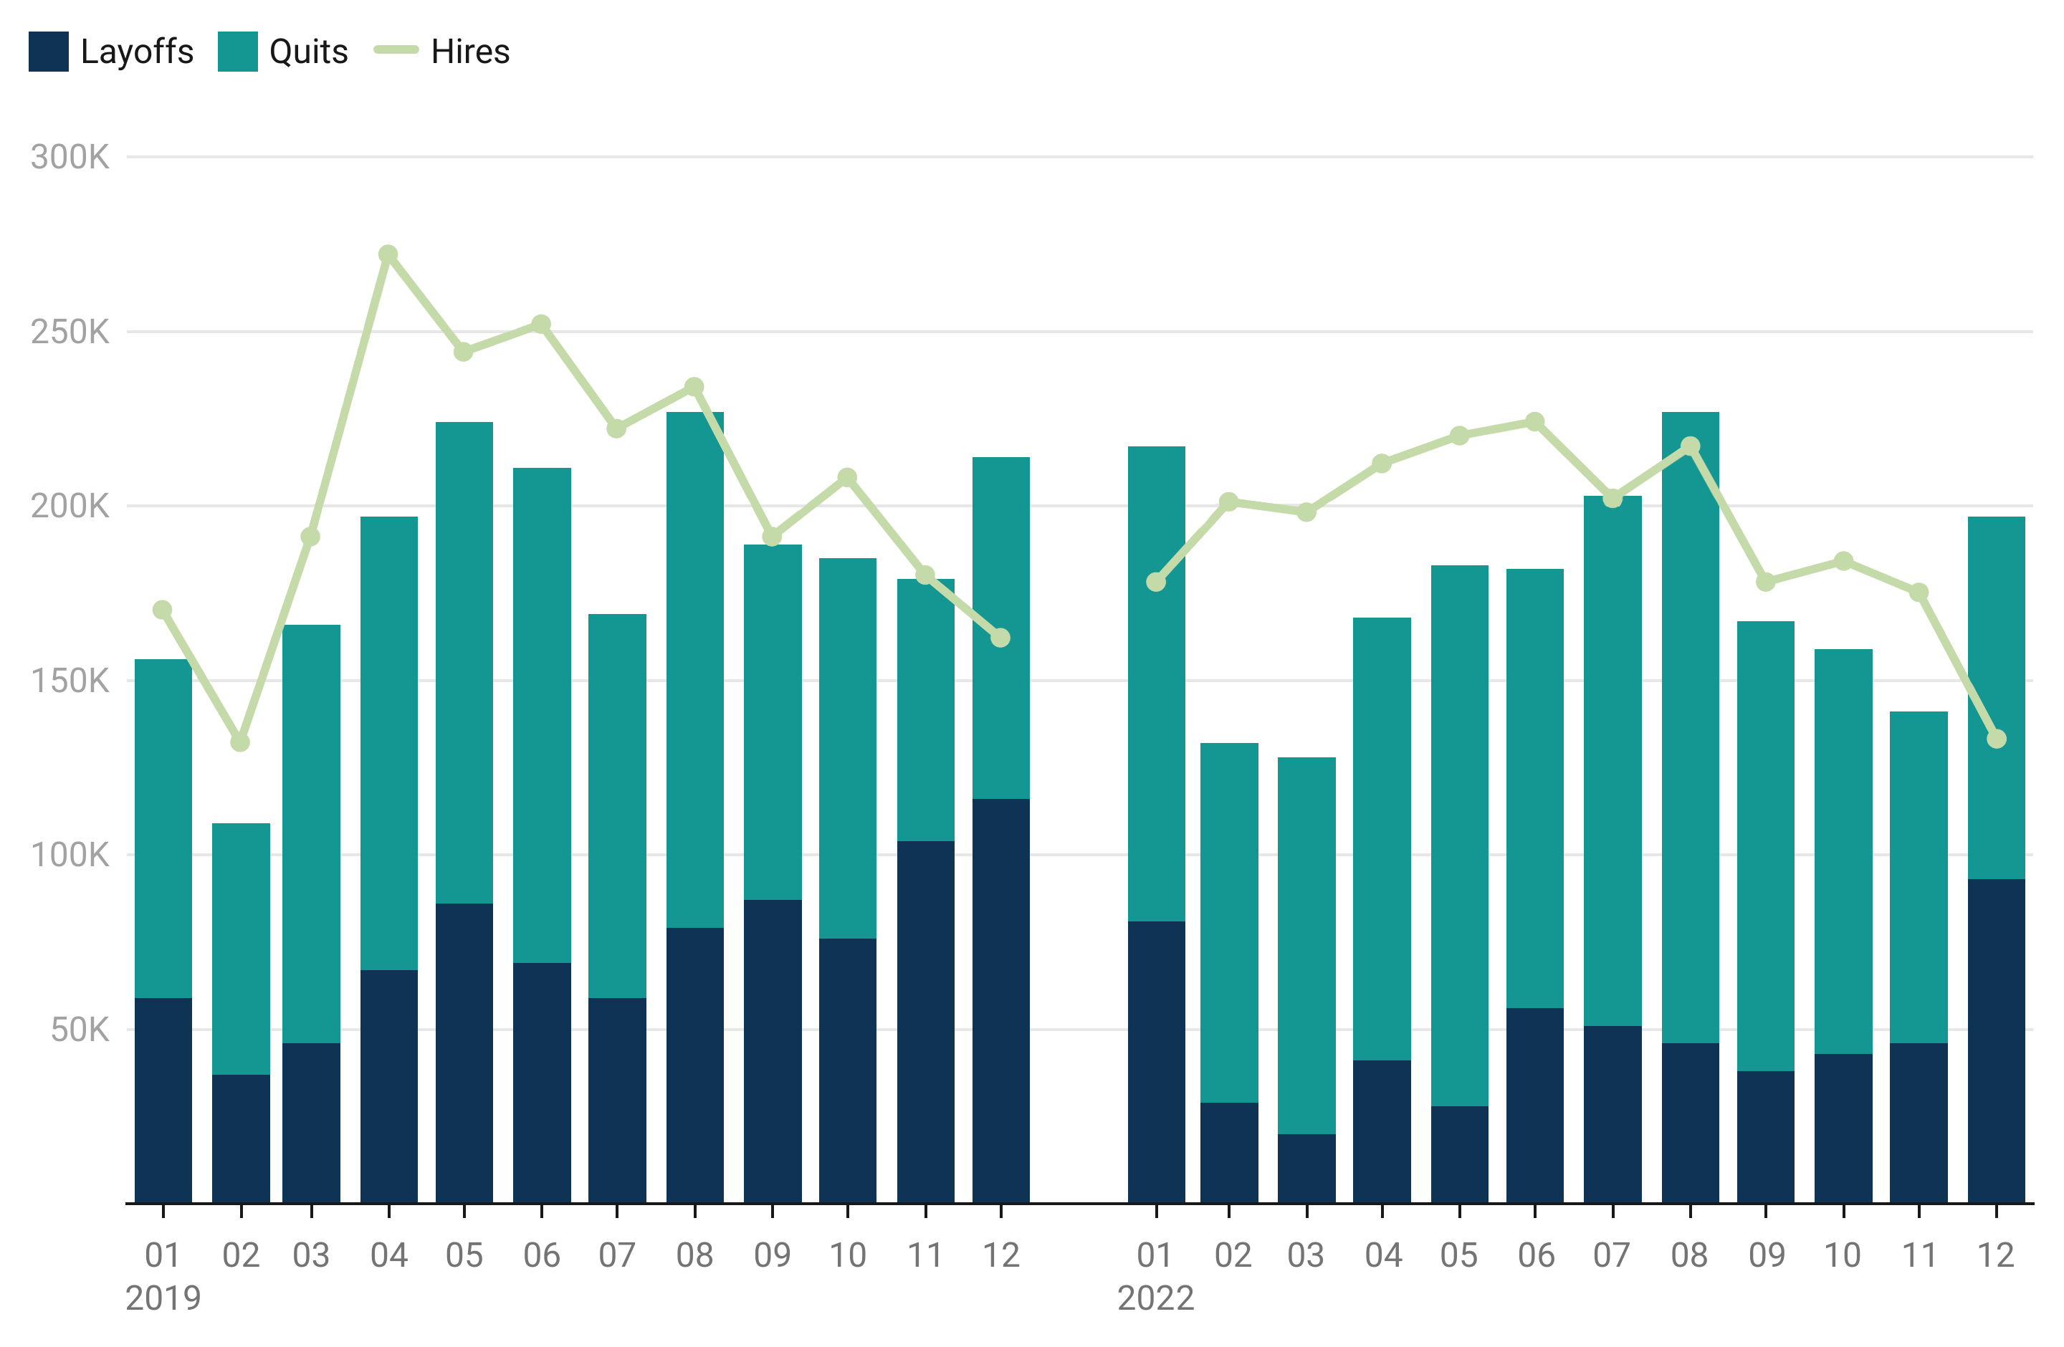
Pennsylvania Workforce Churn: Layoffs & Quits vs. Hires (2019 and 2022)
Turnover in PA in 2022 (vs. 2019) is driven more by employees choosing to quit than employers conducting layoffs​
On average, hiring by employers in 2022 in PA exceeded the combination of quits and layoffs.
US Bureau of Labor Statistics, “Job Openings and Labor Turnover Survey (JOLTS)”; bls.gov/jlt
Notes:
Leaving because of opportunities out there.

Slide 8
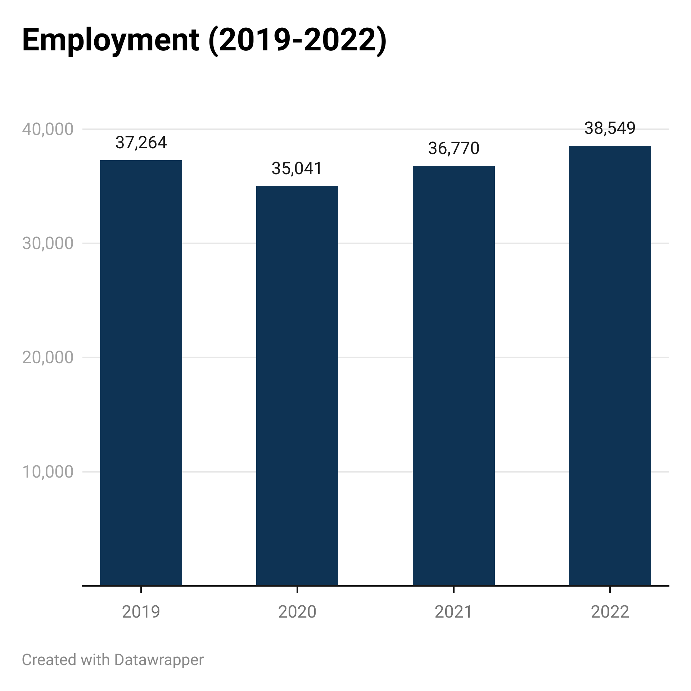
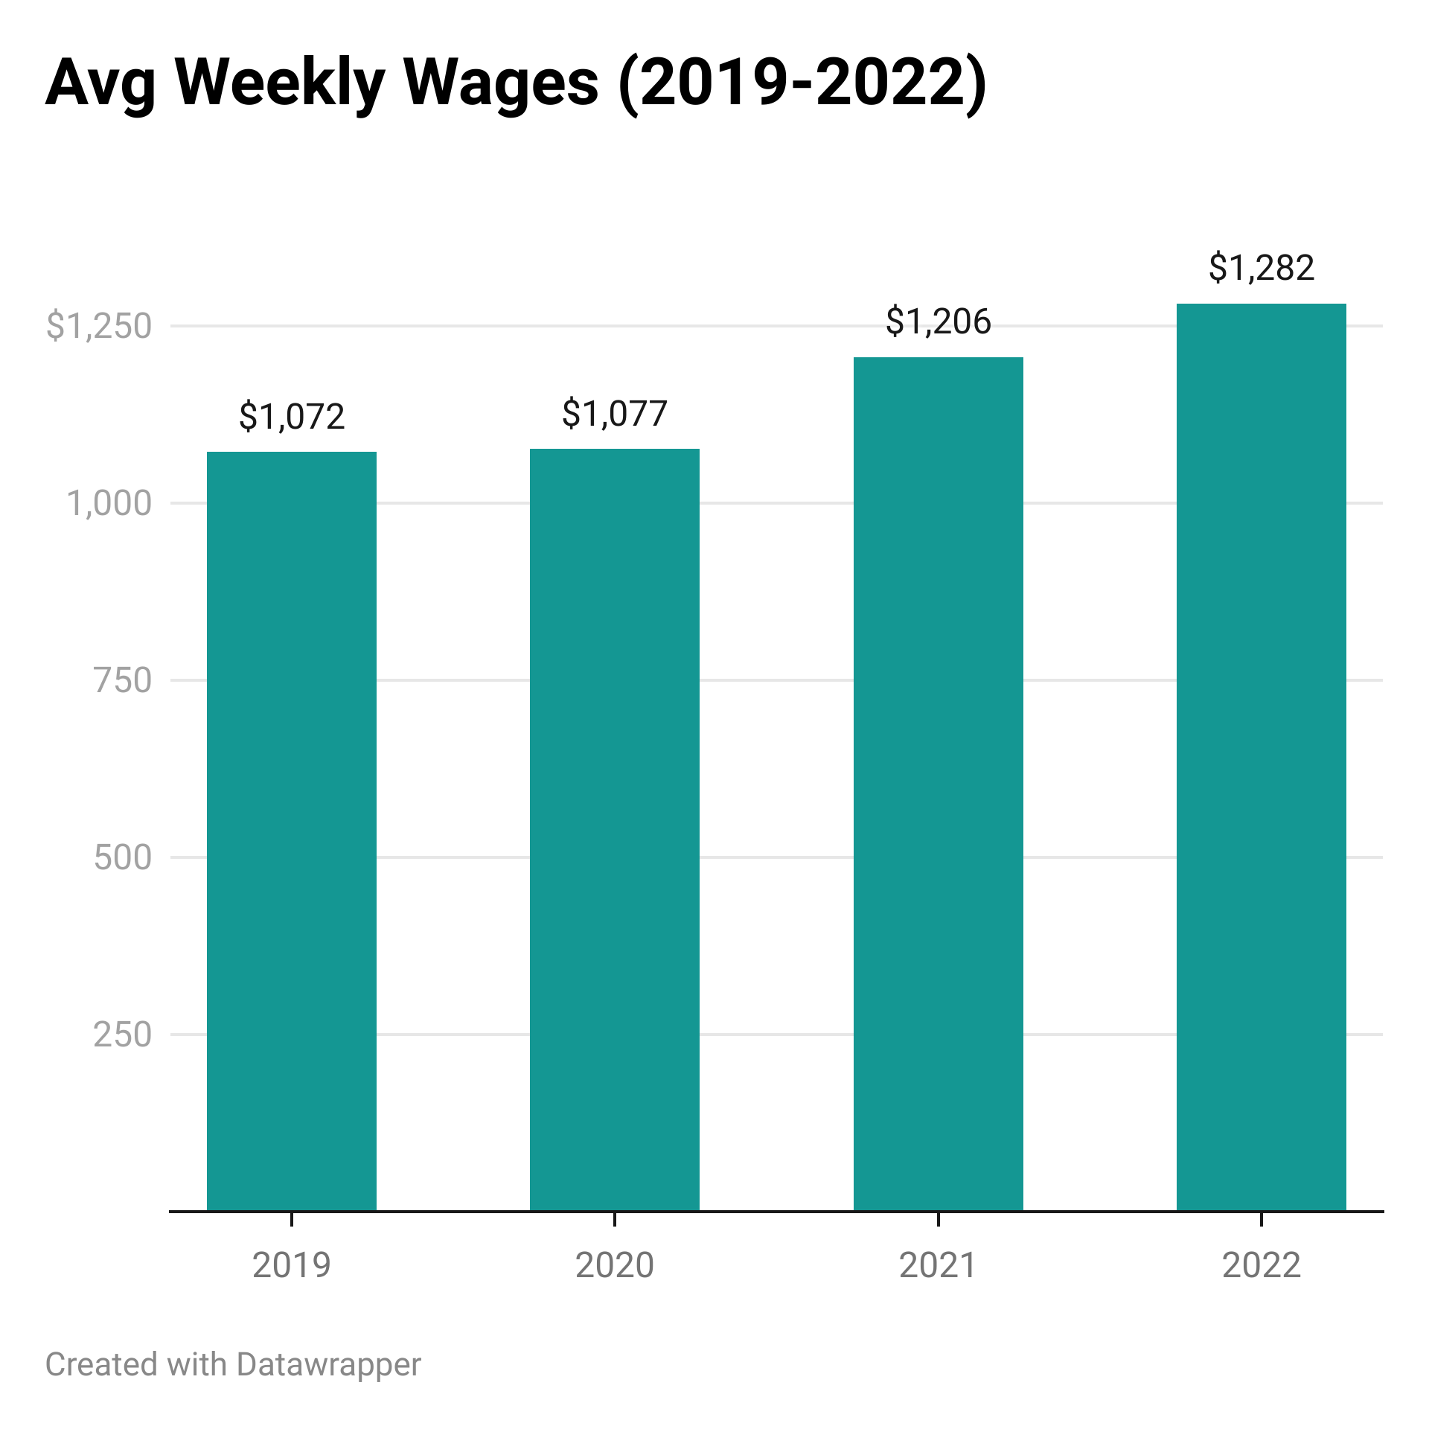
Key Sector Focus: Lancaster County Manufacturing (Q3)
+3.4%
+19.6%
US Bureau of Labor Statistics, “Quarterly Census of Employment and Wages”; bls.gov/cew
Notes:
Q3 data

Slide 9
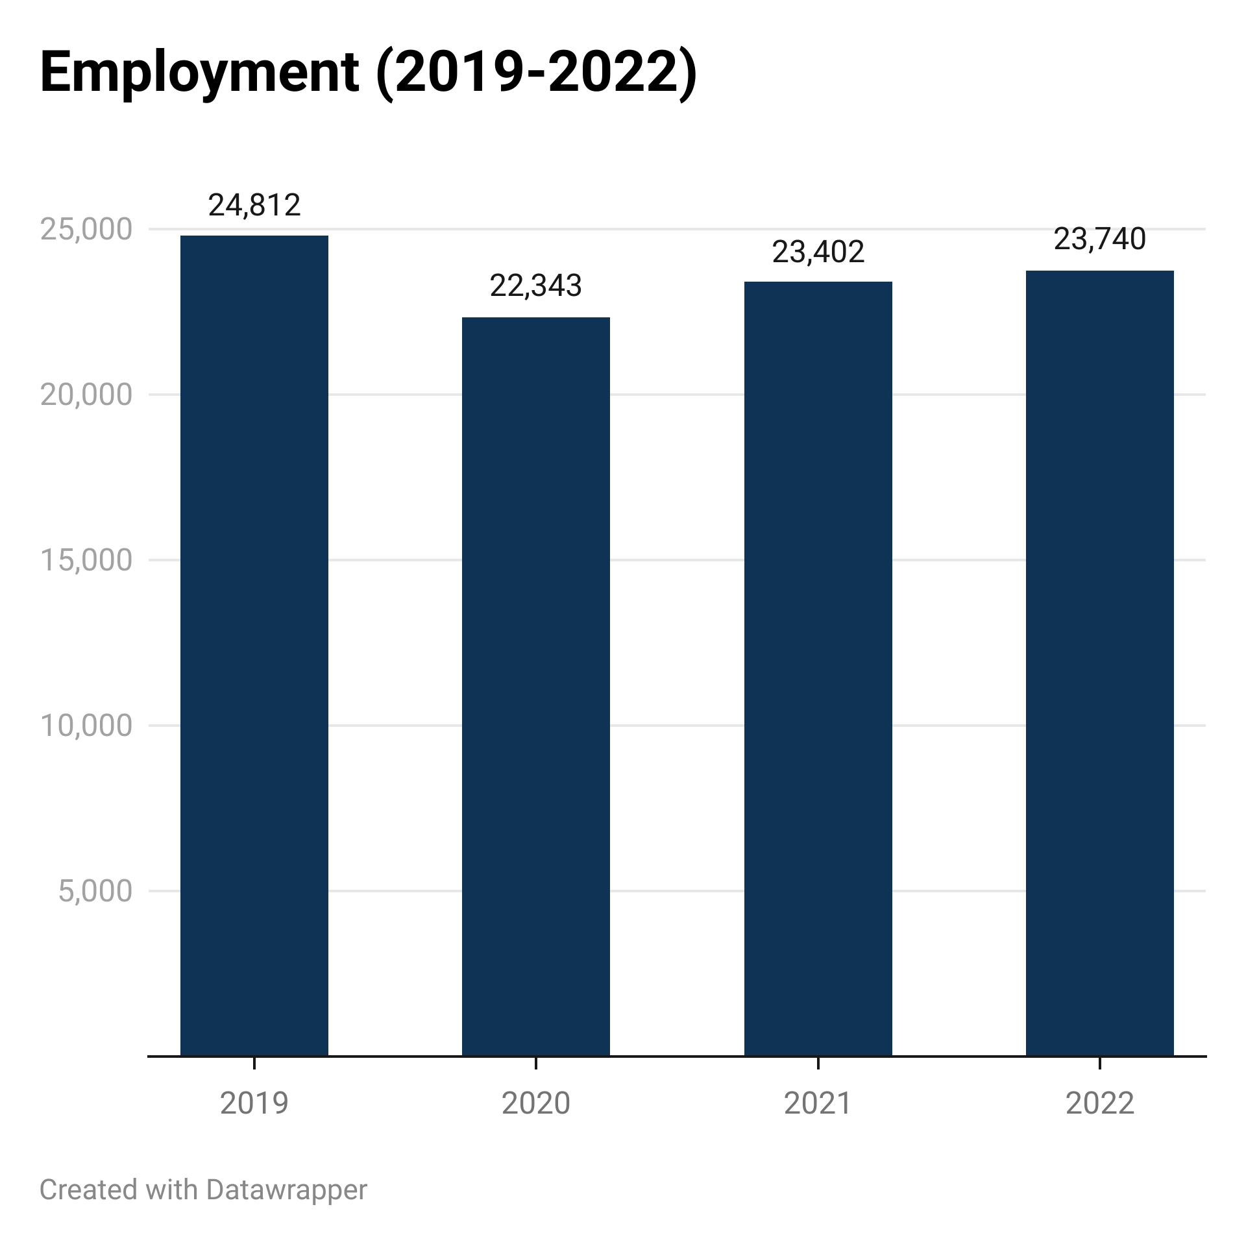
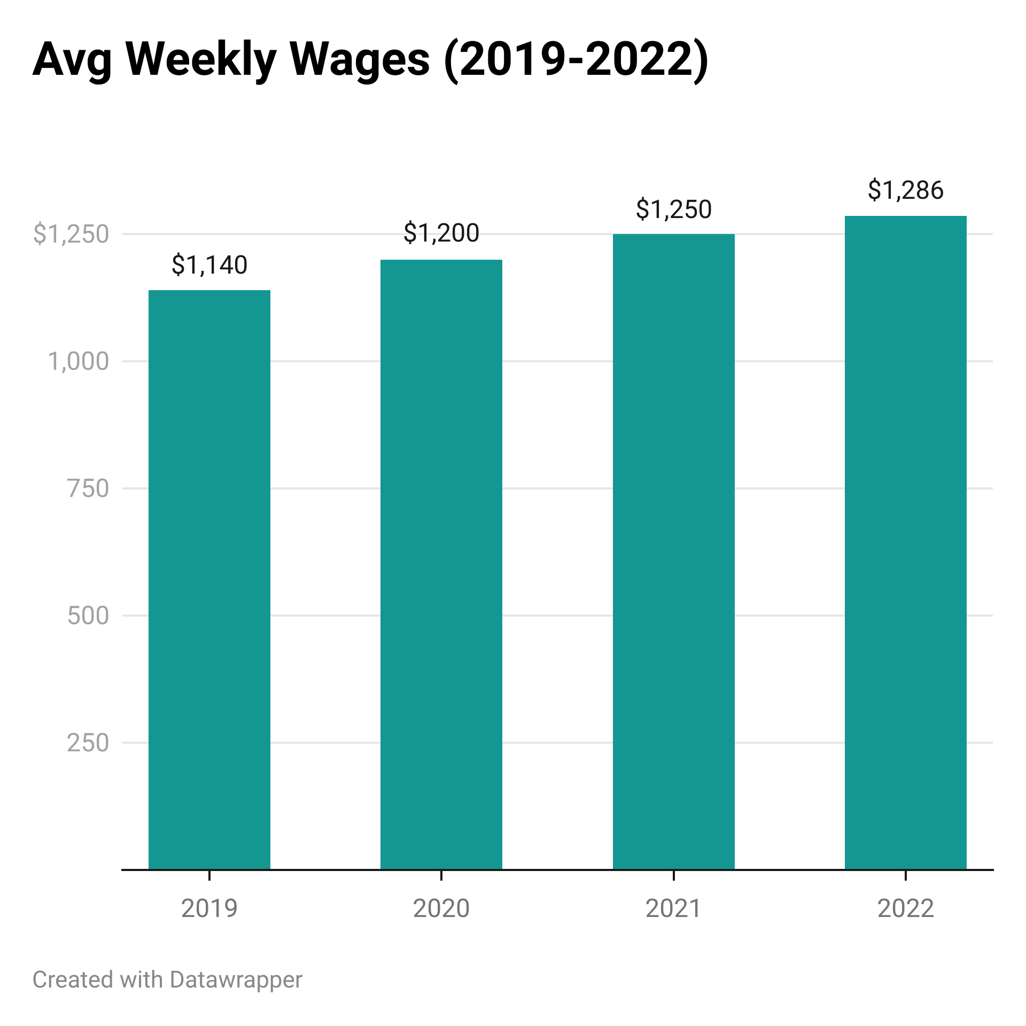
Key Sector Focus: Lancaster County Professional & Business Services (Q3)
-4.3%
+12.8%
US Bureau of Labor Statistics, “Quarterly Census of Employment and Wages”; bls.gov/cew

Slide 10
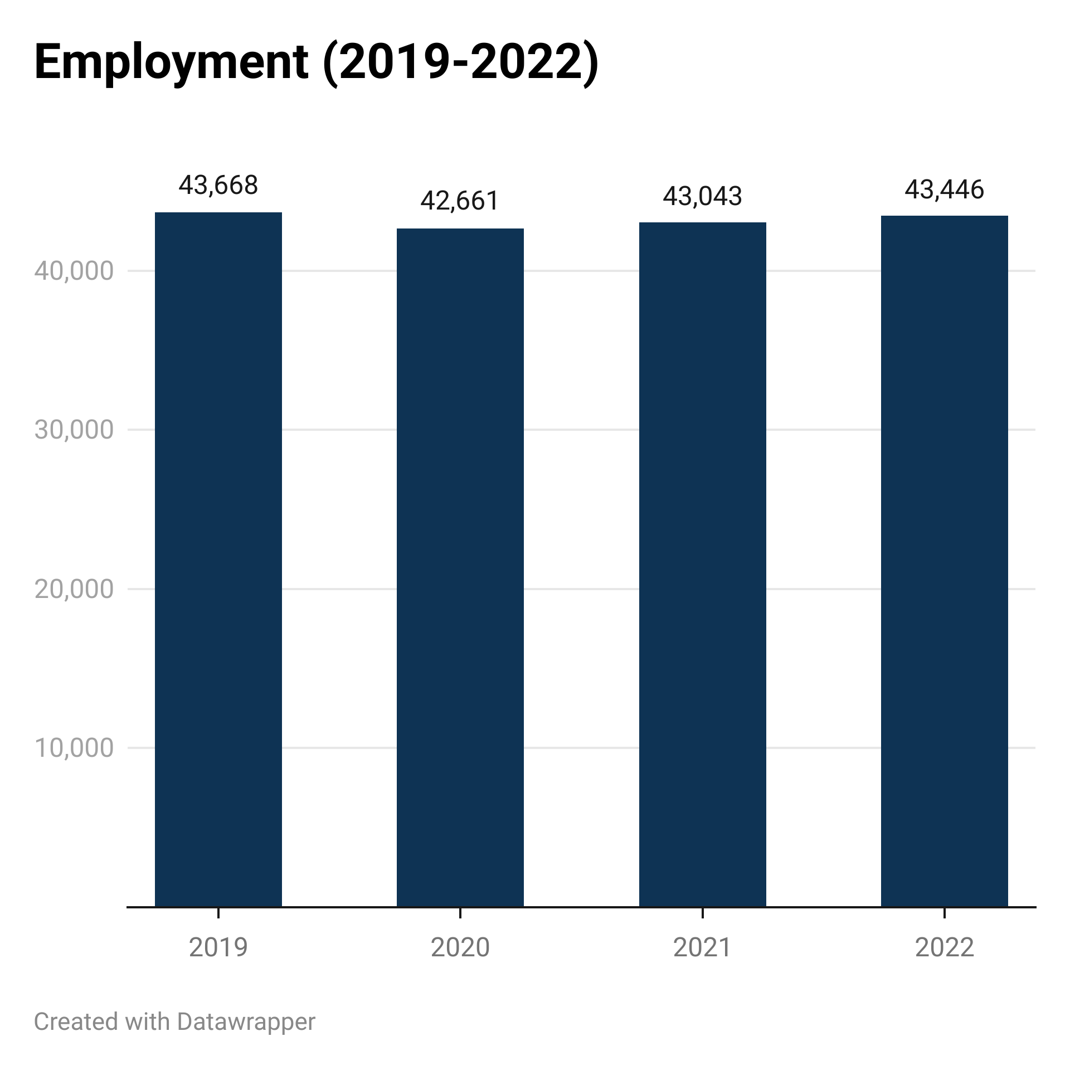
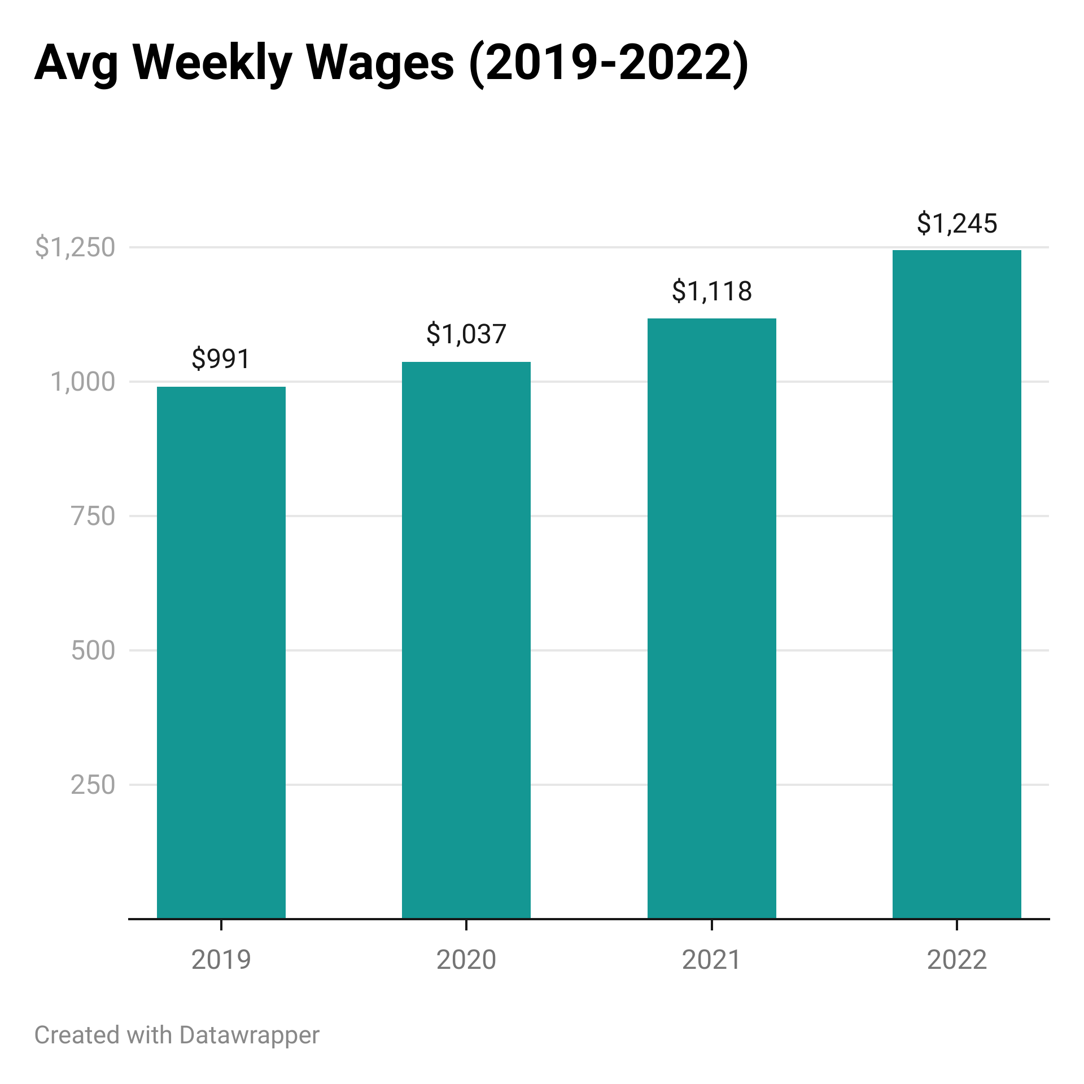
Key Sector Focus: Lancaster County Education & Health Services (Q3)
-0.5%
+25.6%
US Bureau of Labor Statistics, “Quarterly Census of Employment and Wages”; bls.gov/cew

Slide 11
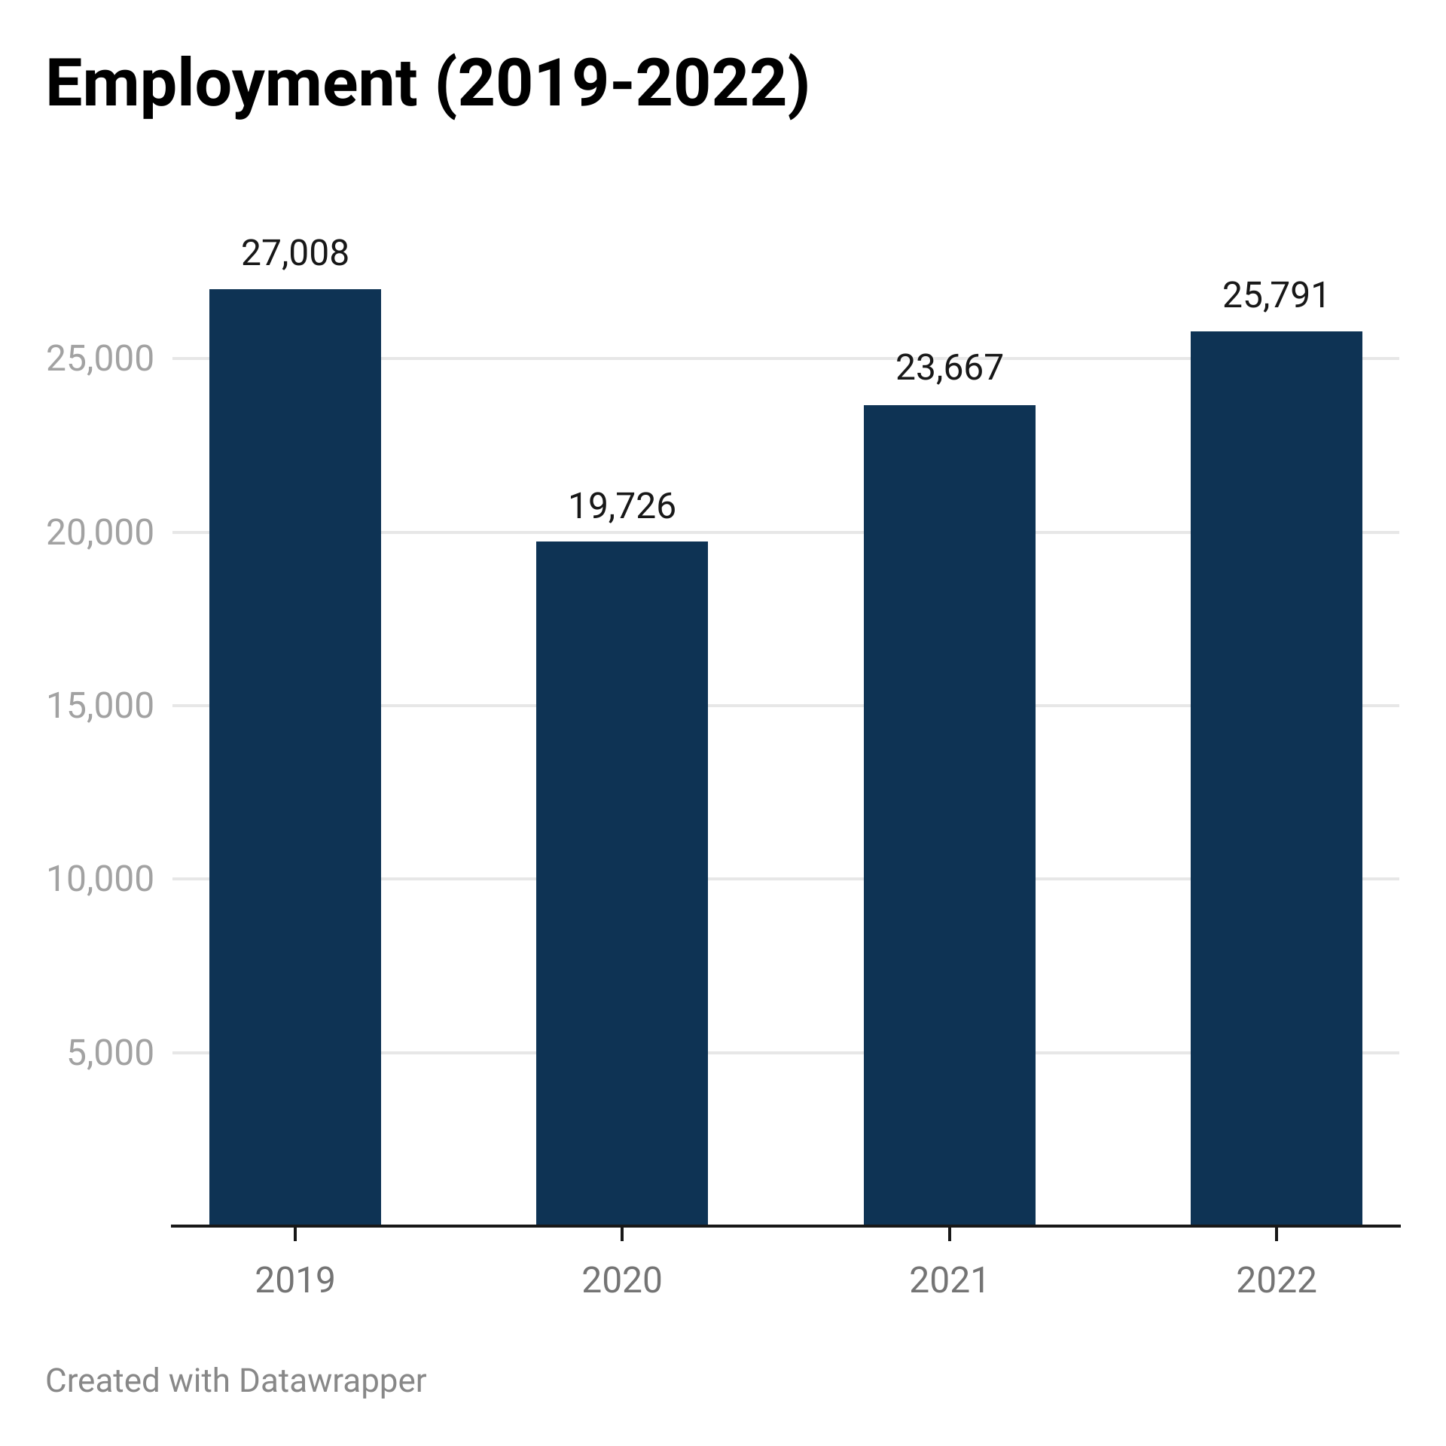
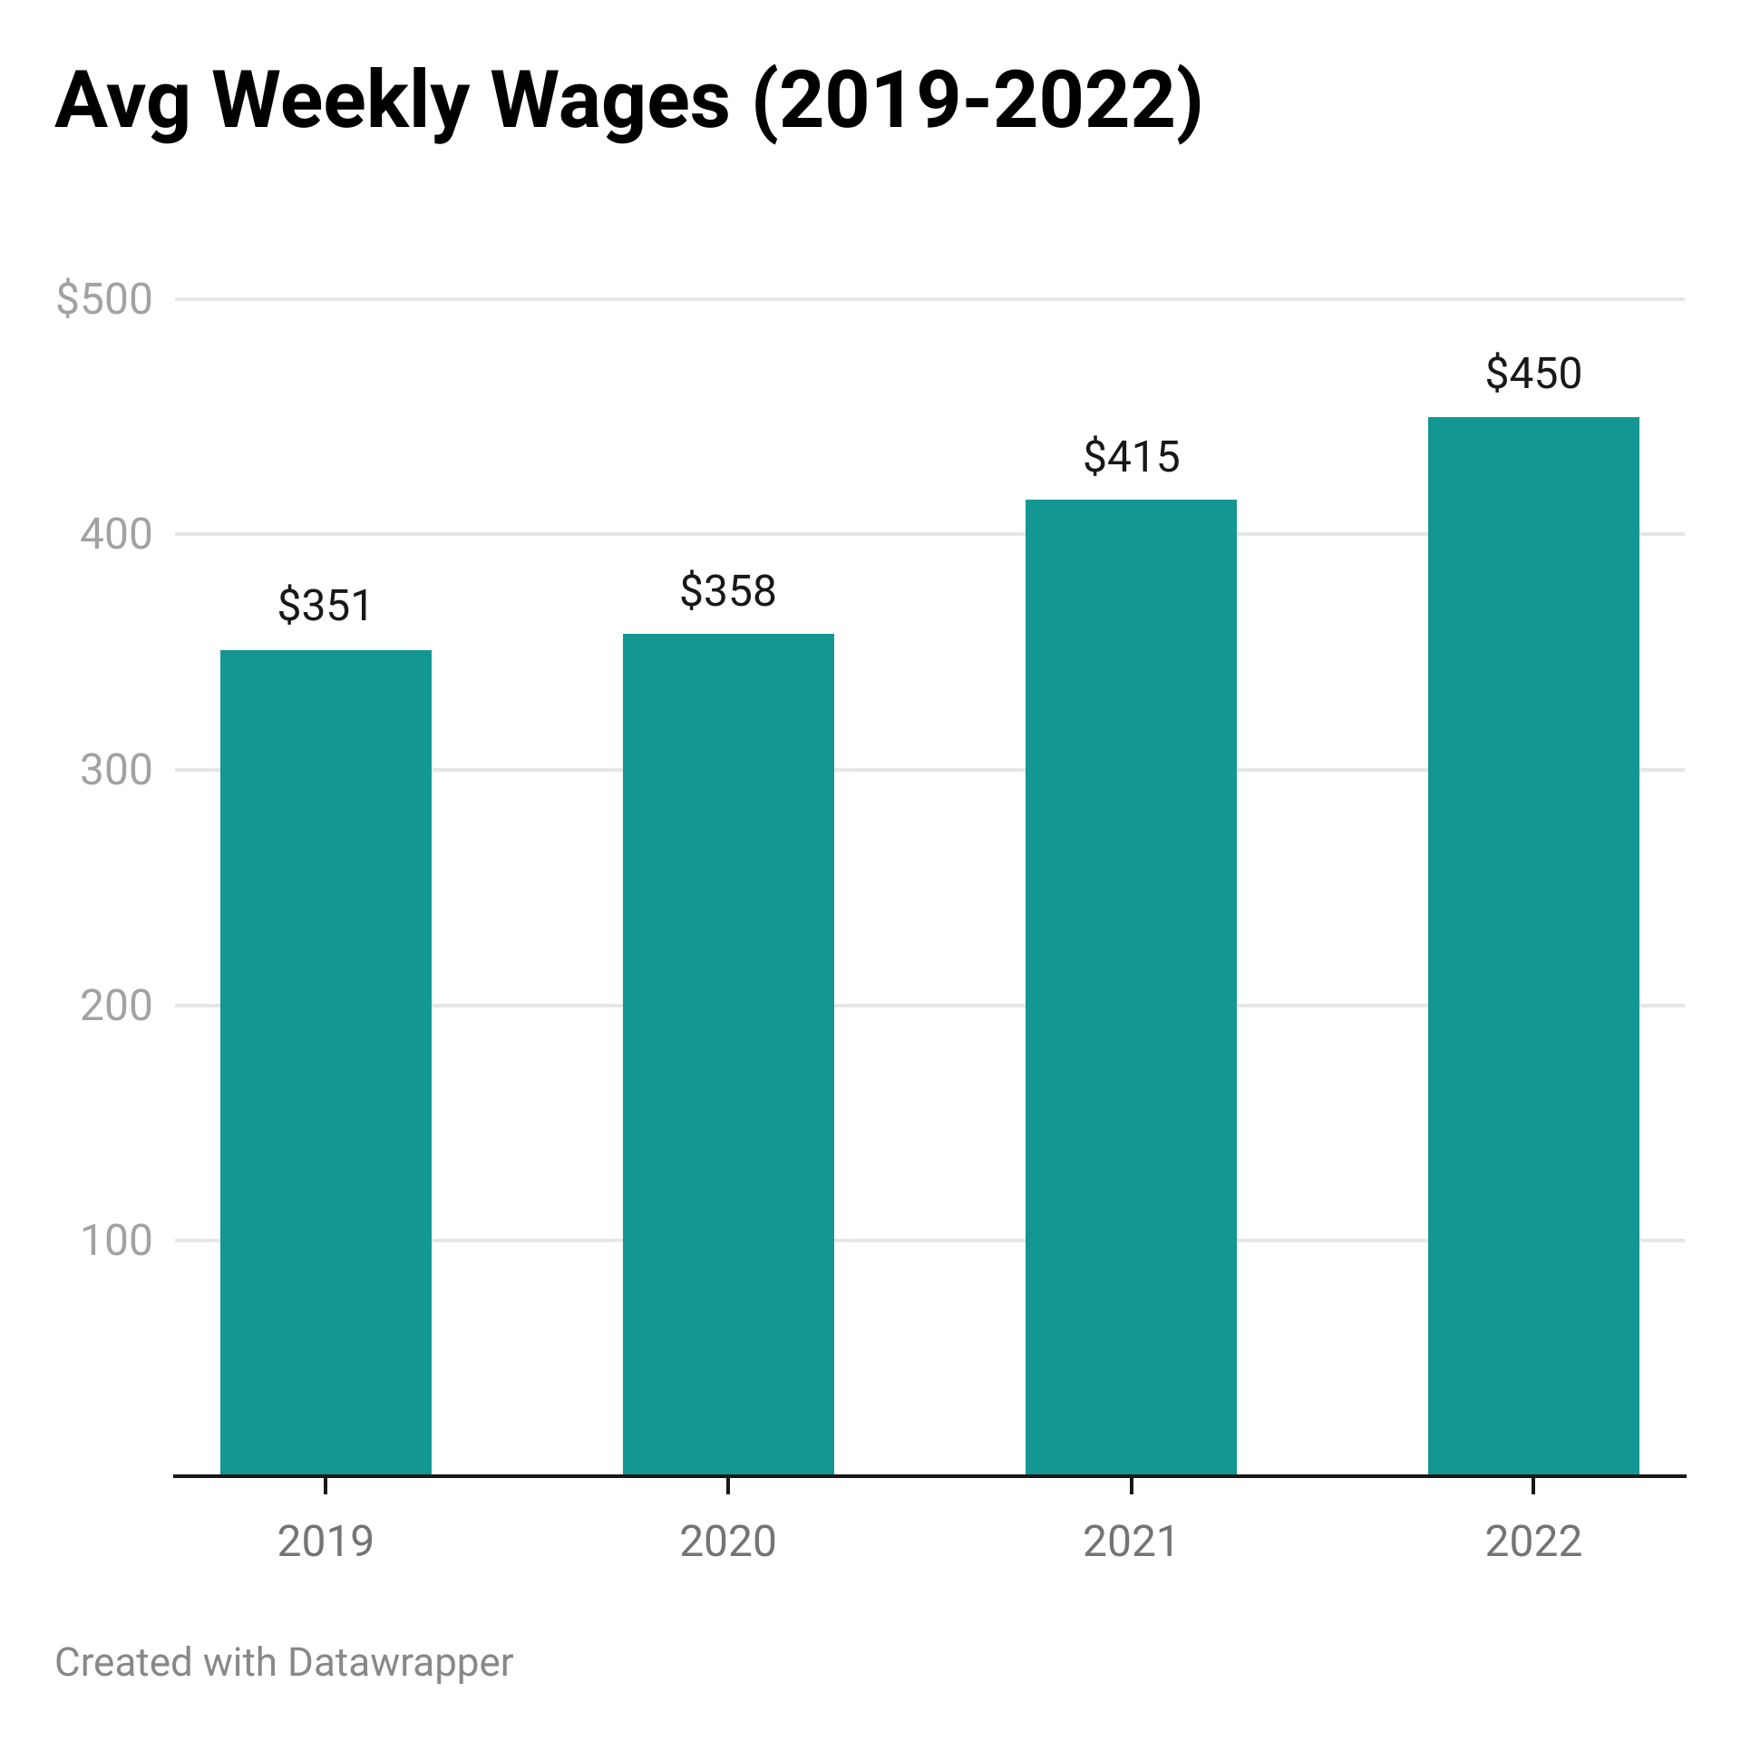
Key Sector Focus: Lancaster County Leisure & Hospitality (Q3)
-4.5%
+28.2%
US Bureau of Labor Statistics, “Quarterly Census of Employment and Wages”; bls.gov/cew

Slide 12
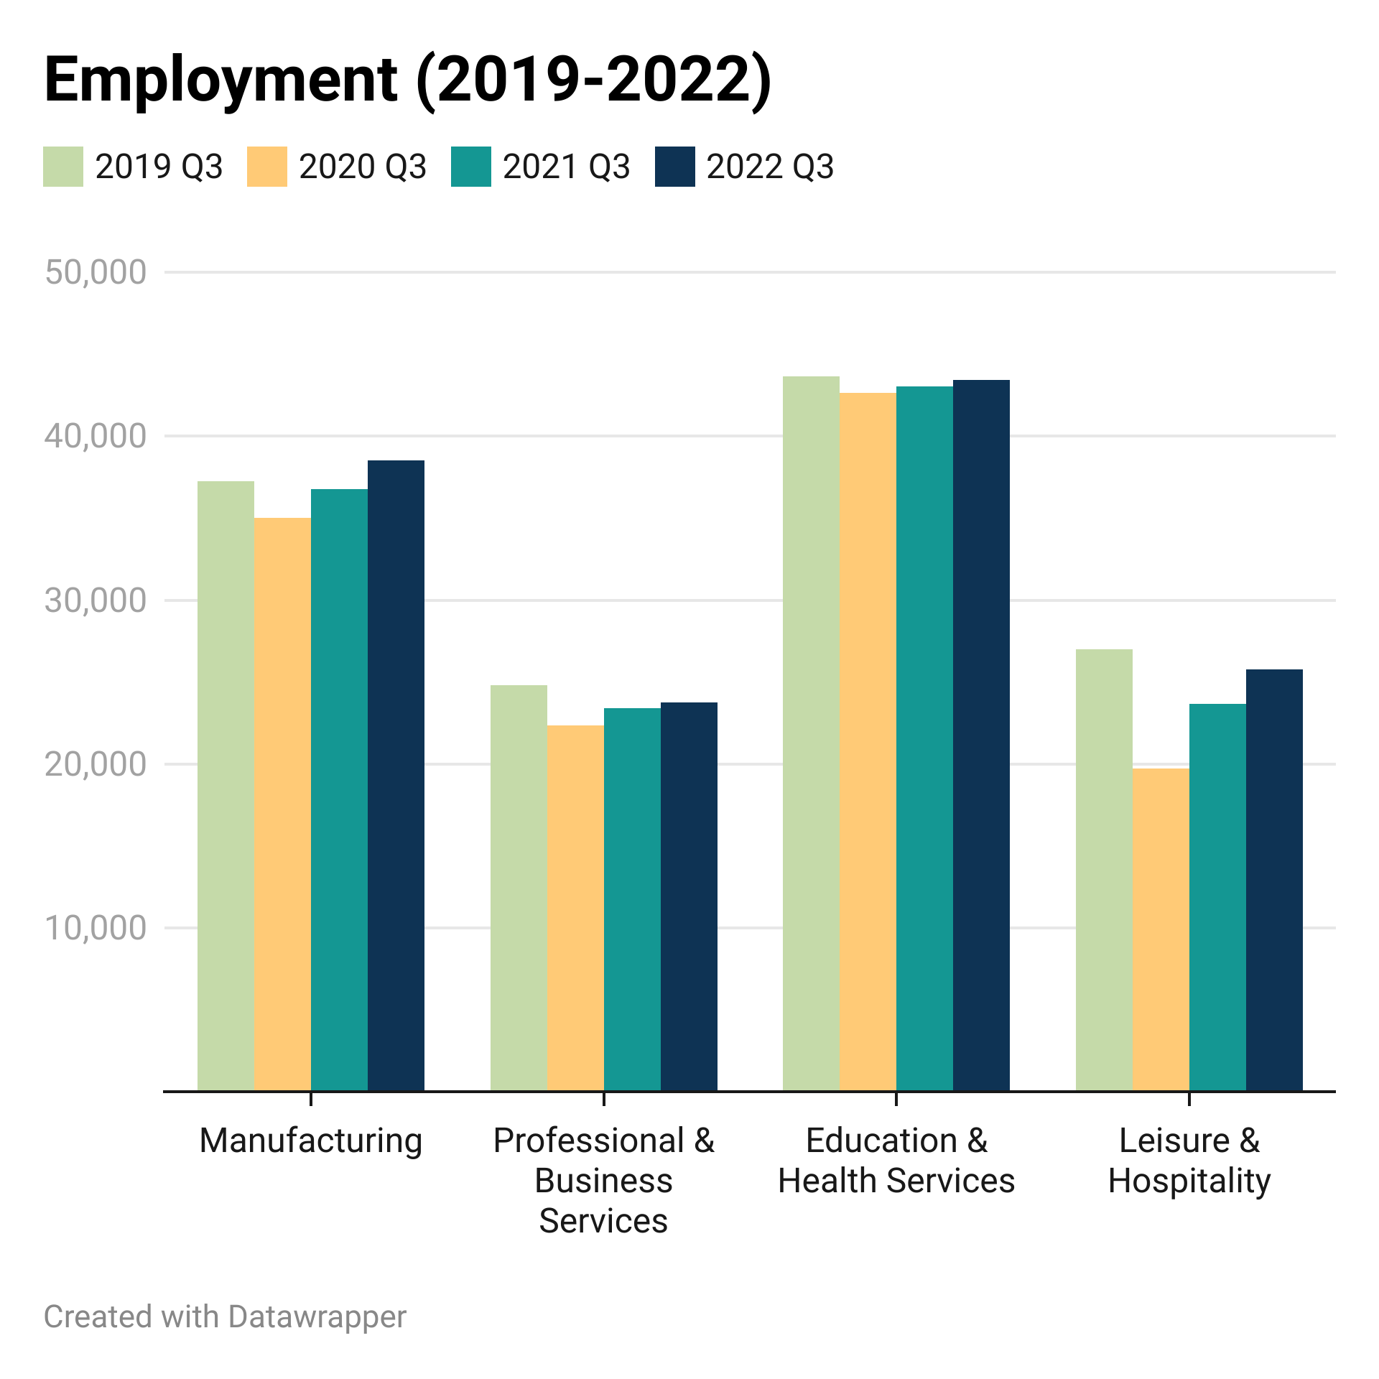
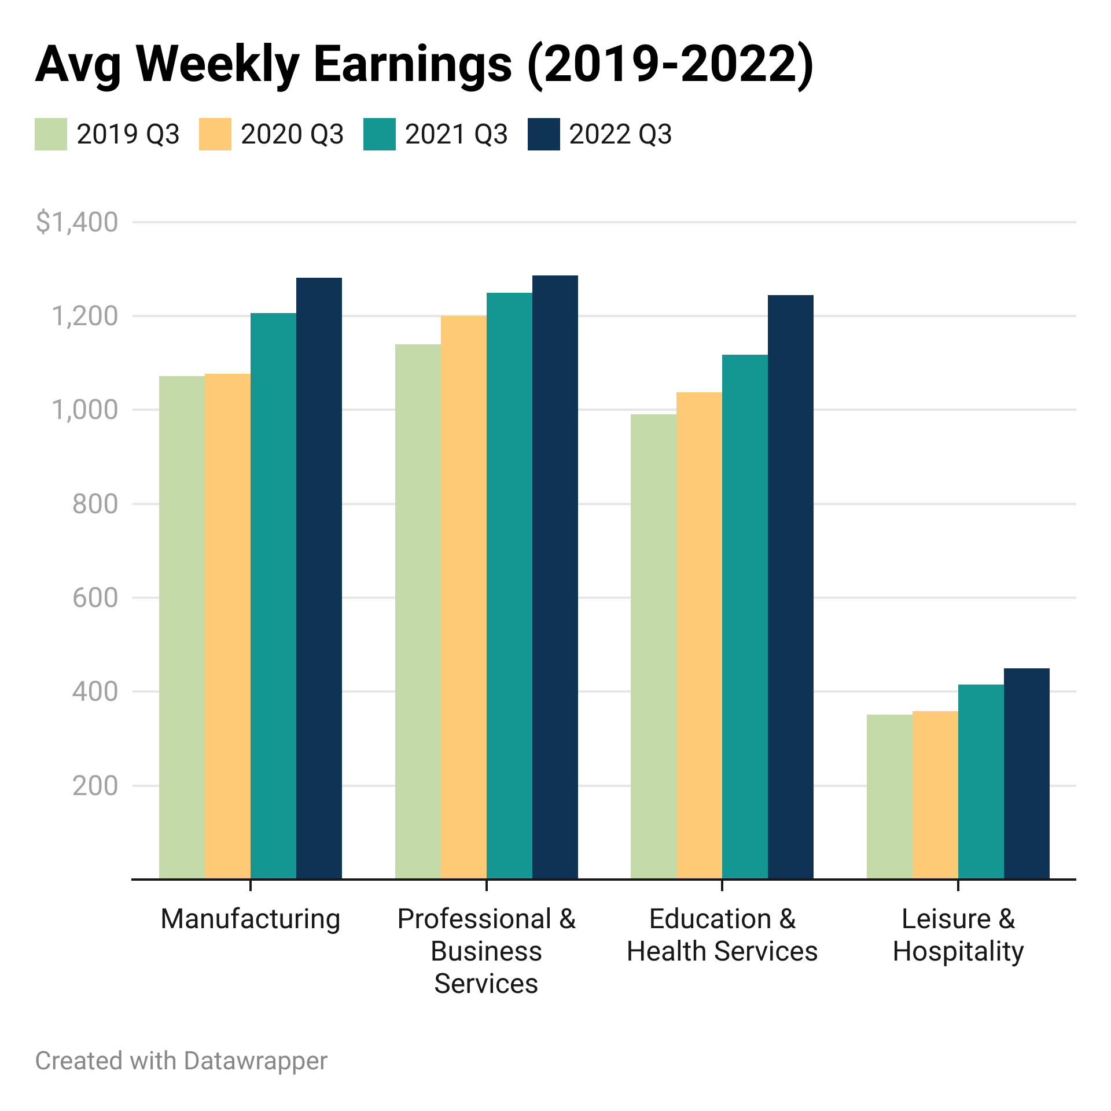
Key Sector Comparison: Lancaster County Employment & Wages (Q3)
US Bureau of Labor Statistics, “Quarterly Census of Employment and Wages”; bls.gov/cew
Notes:
Great example… at that time.. Business velocity still strong.. In general at or under 2019 levels…

Slide 13
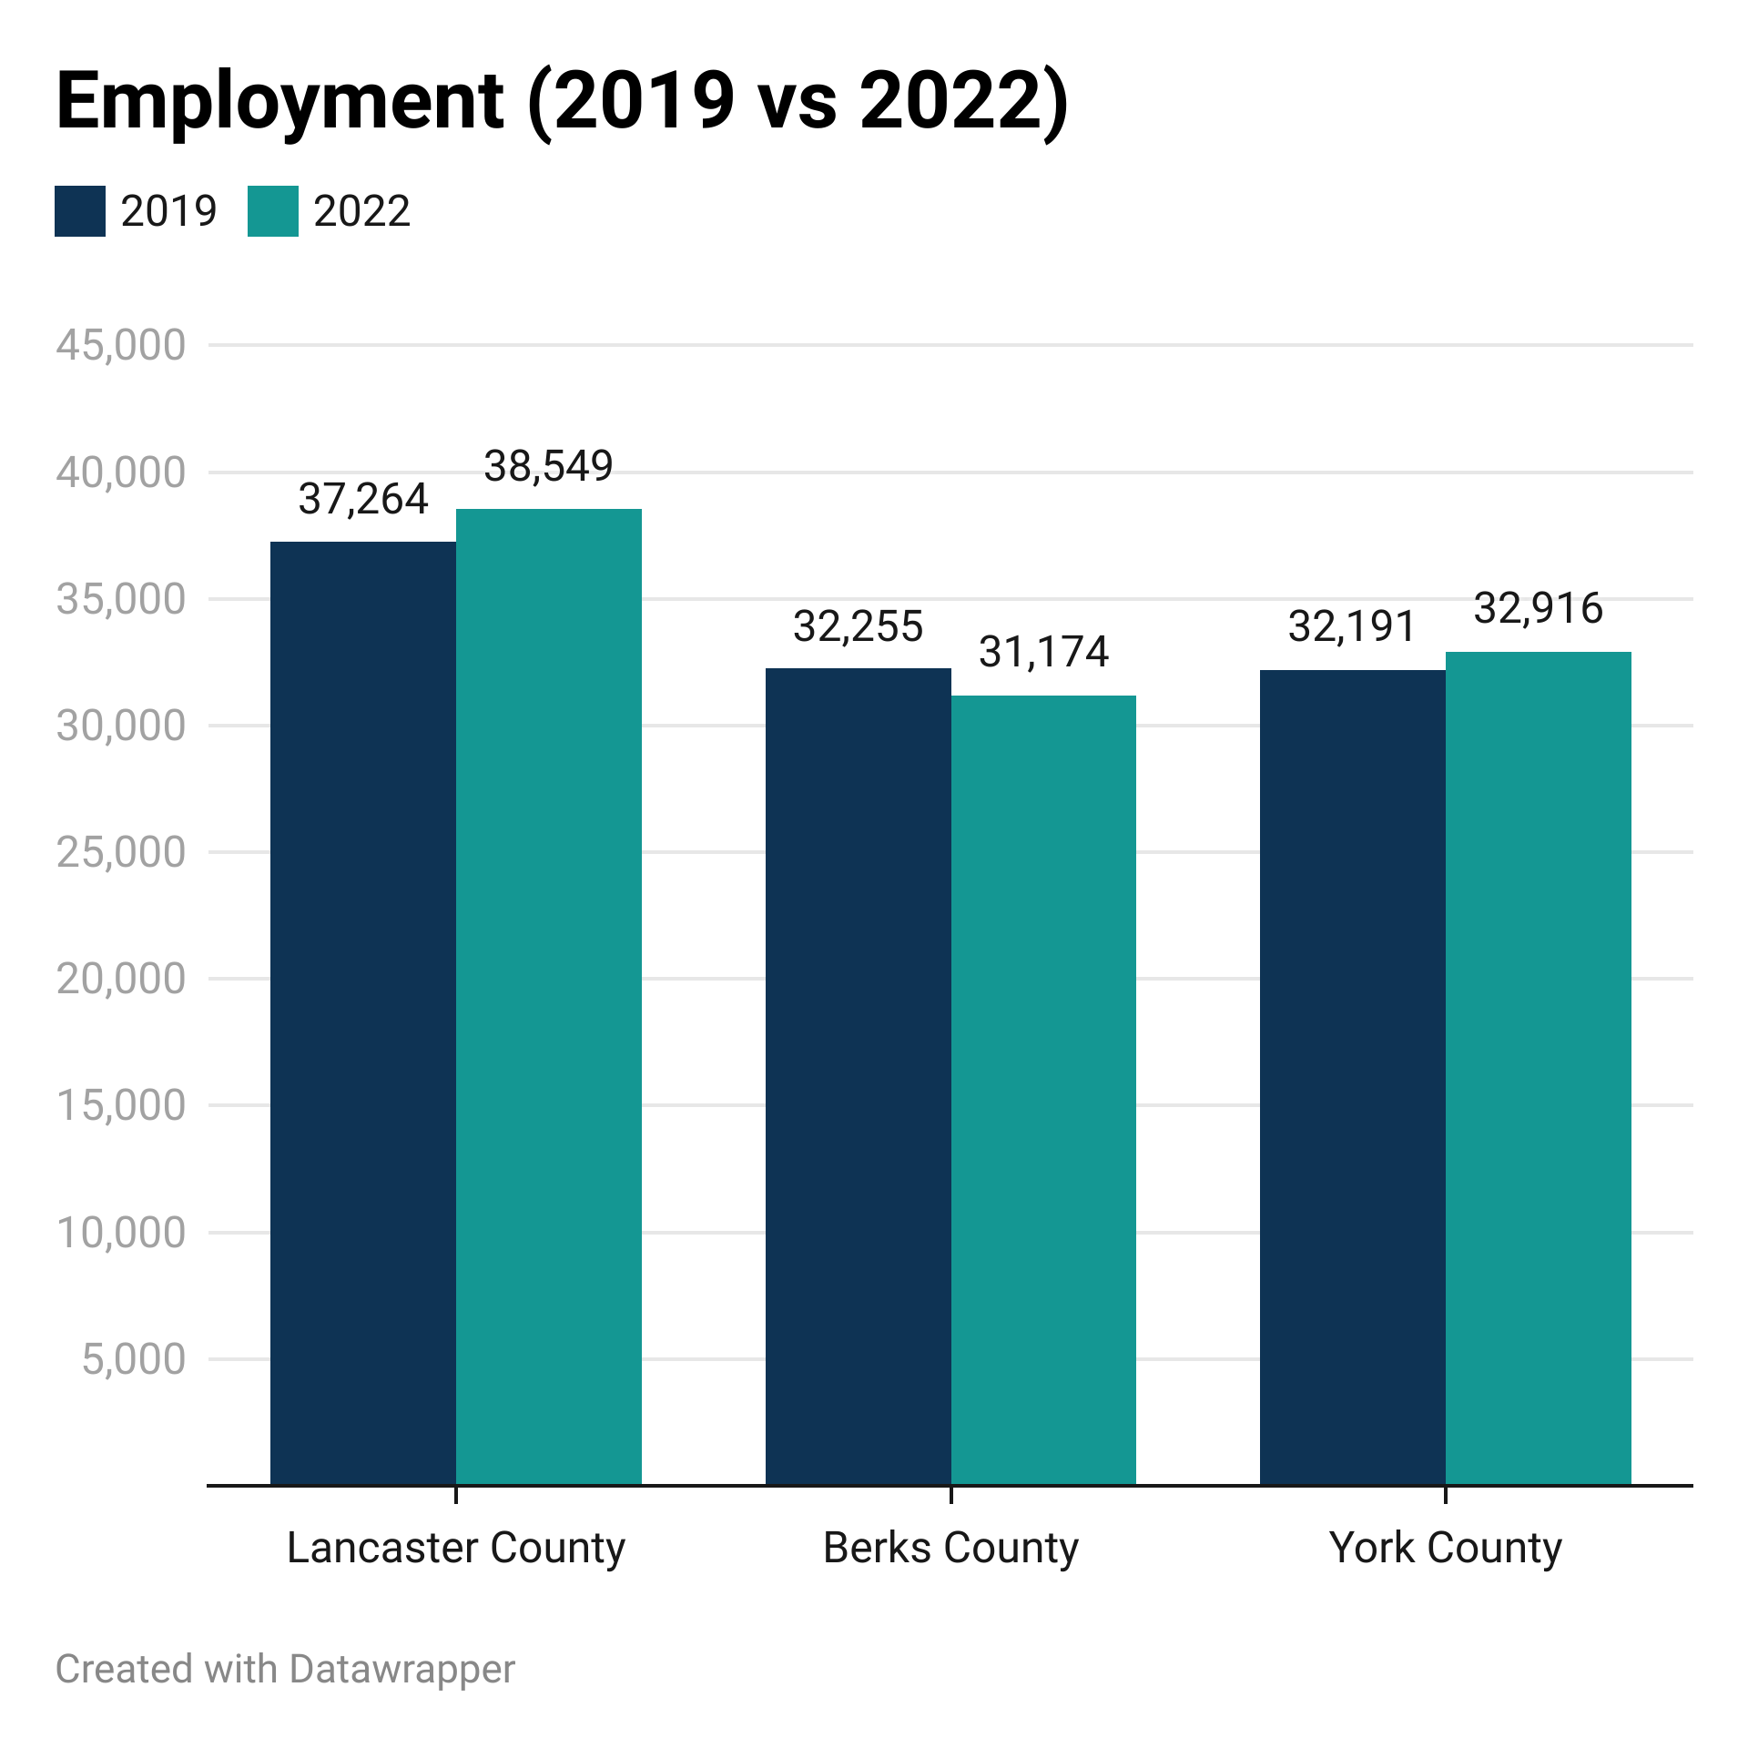
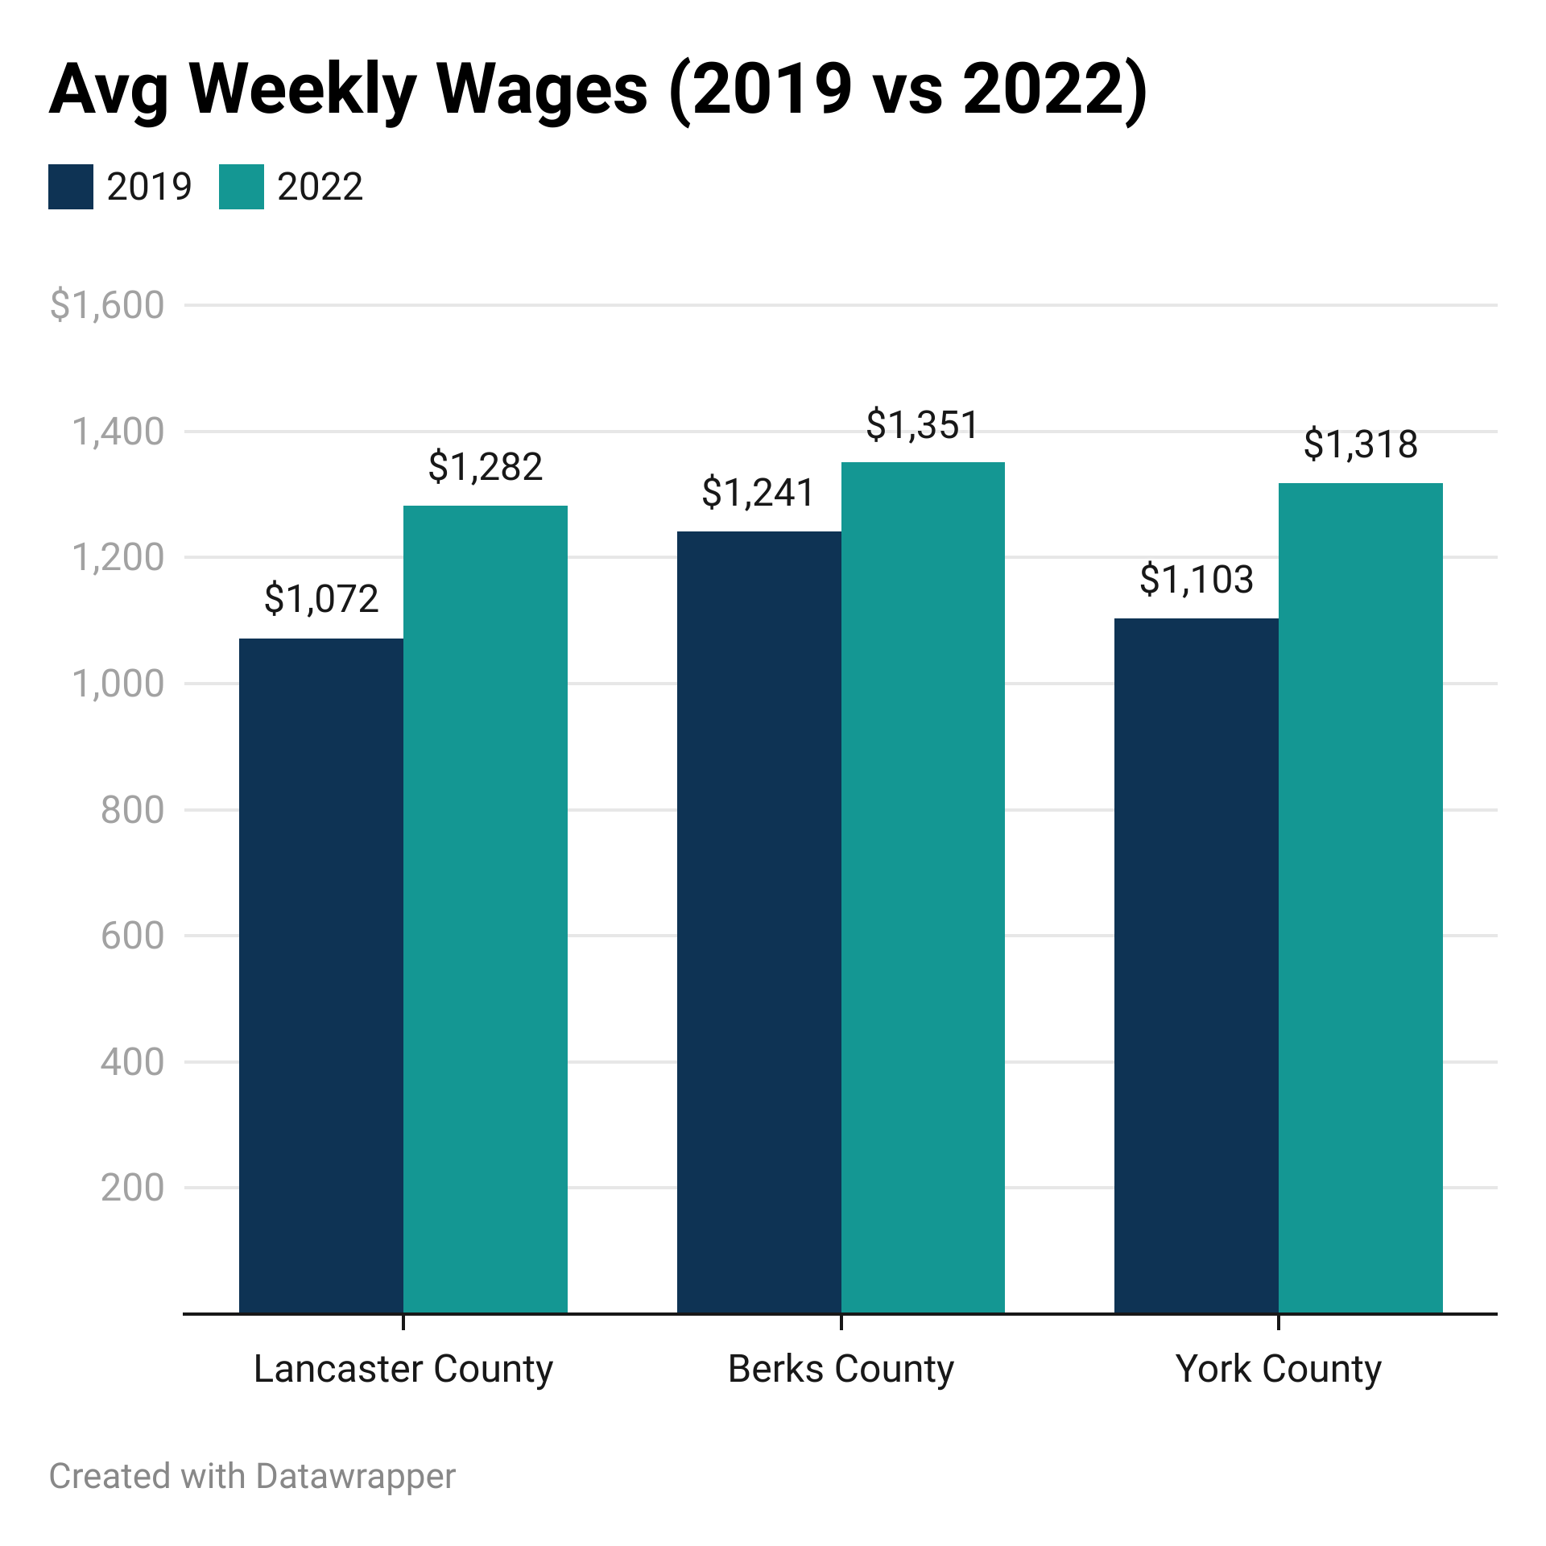
Regional Comparison of Key Sectors: Manufacturing (Q3)
US Bureau of Labor Statistics, “Quarterly Census of Employment and Wages”; bls.gov/cew

Slide 14
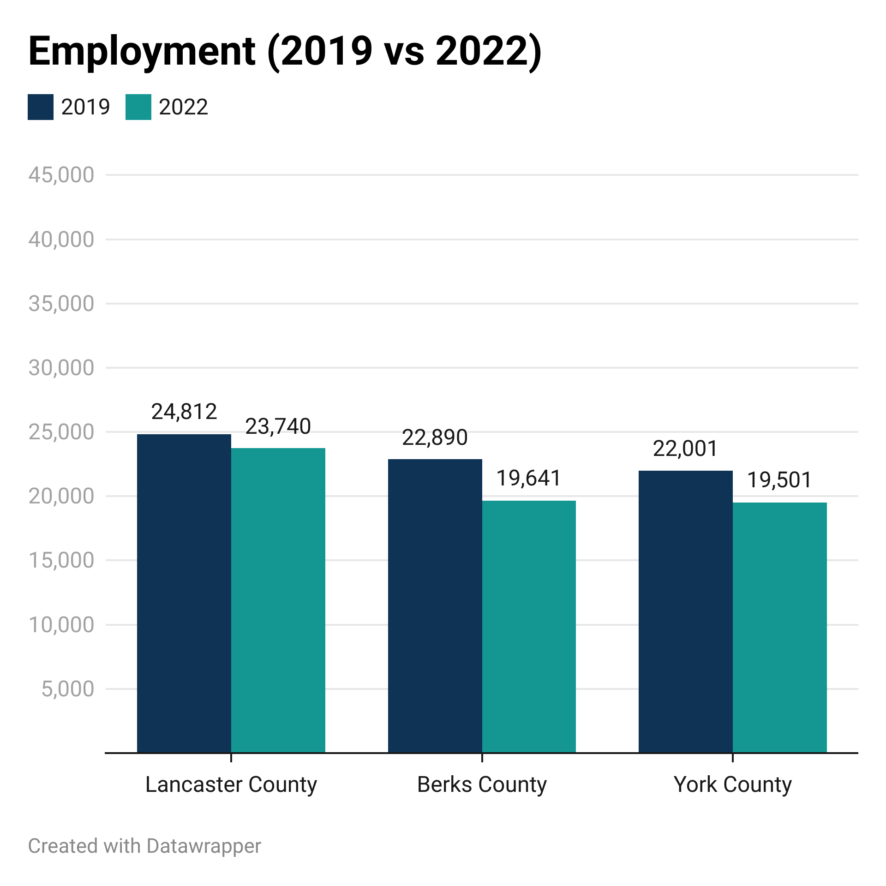
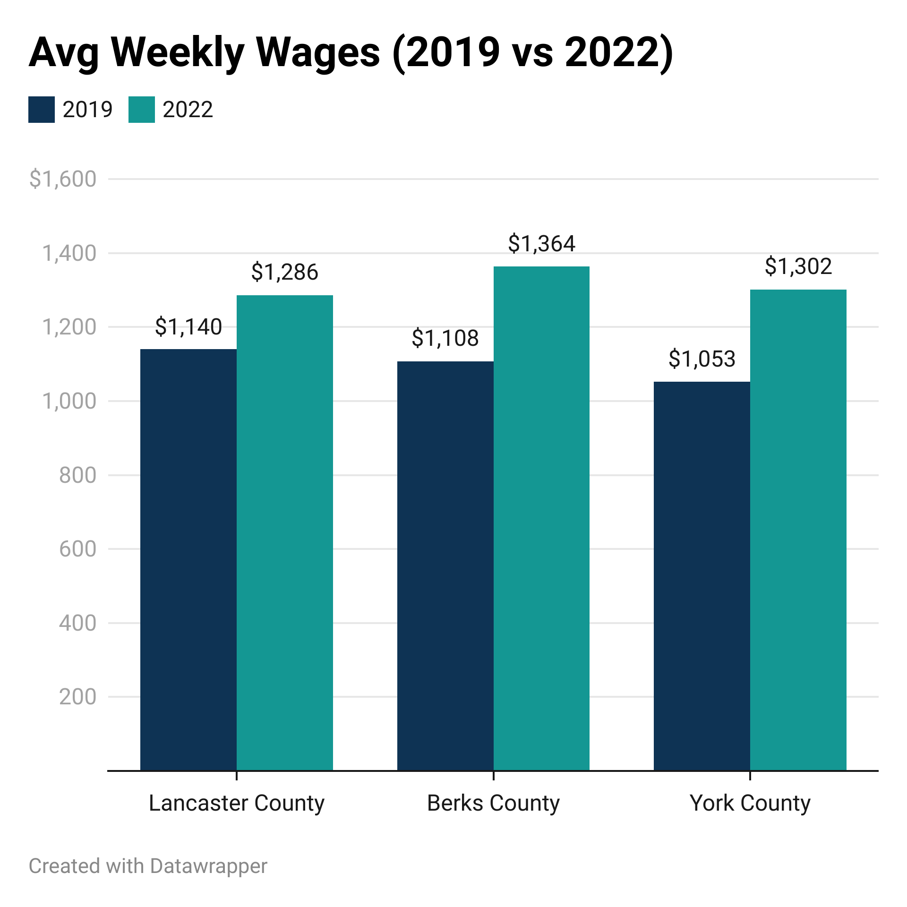
Regional Comparison of Key Sectors: Professional & Business Services (Q3)
US Bureau of Labor Statistics, “Quarterly Census of Employment and Wages”; bls.gov/cew

Slide 15
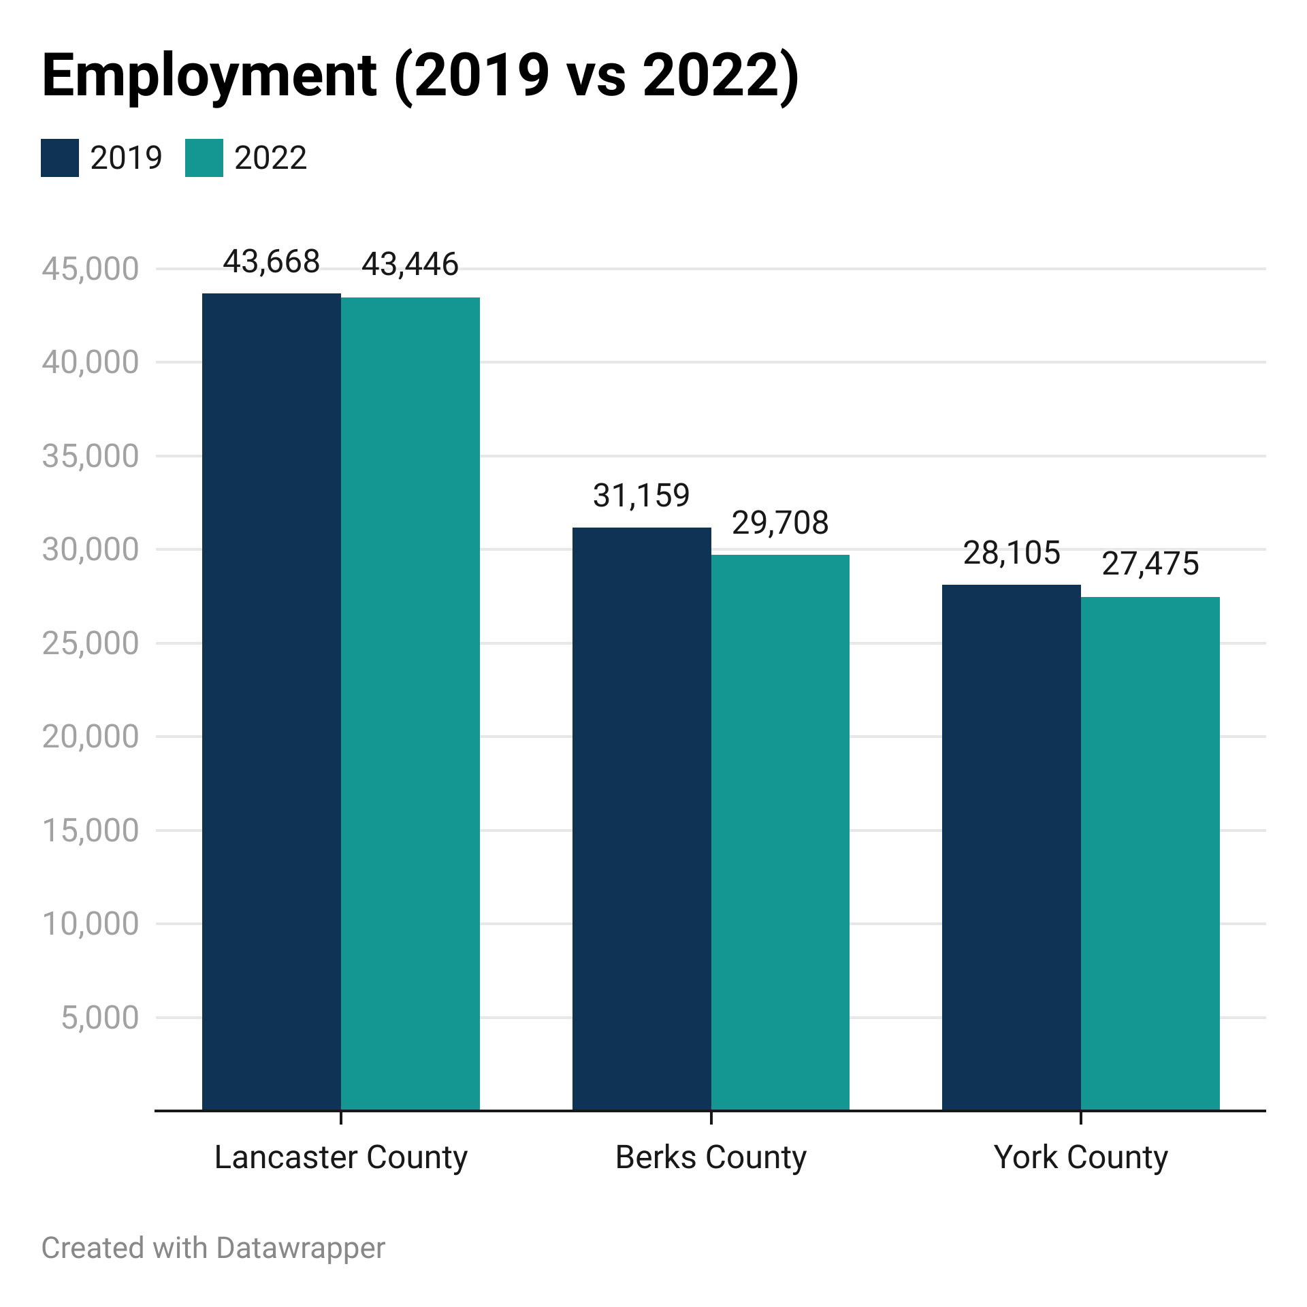
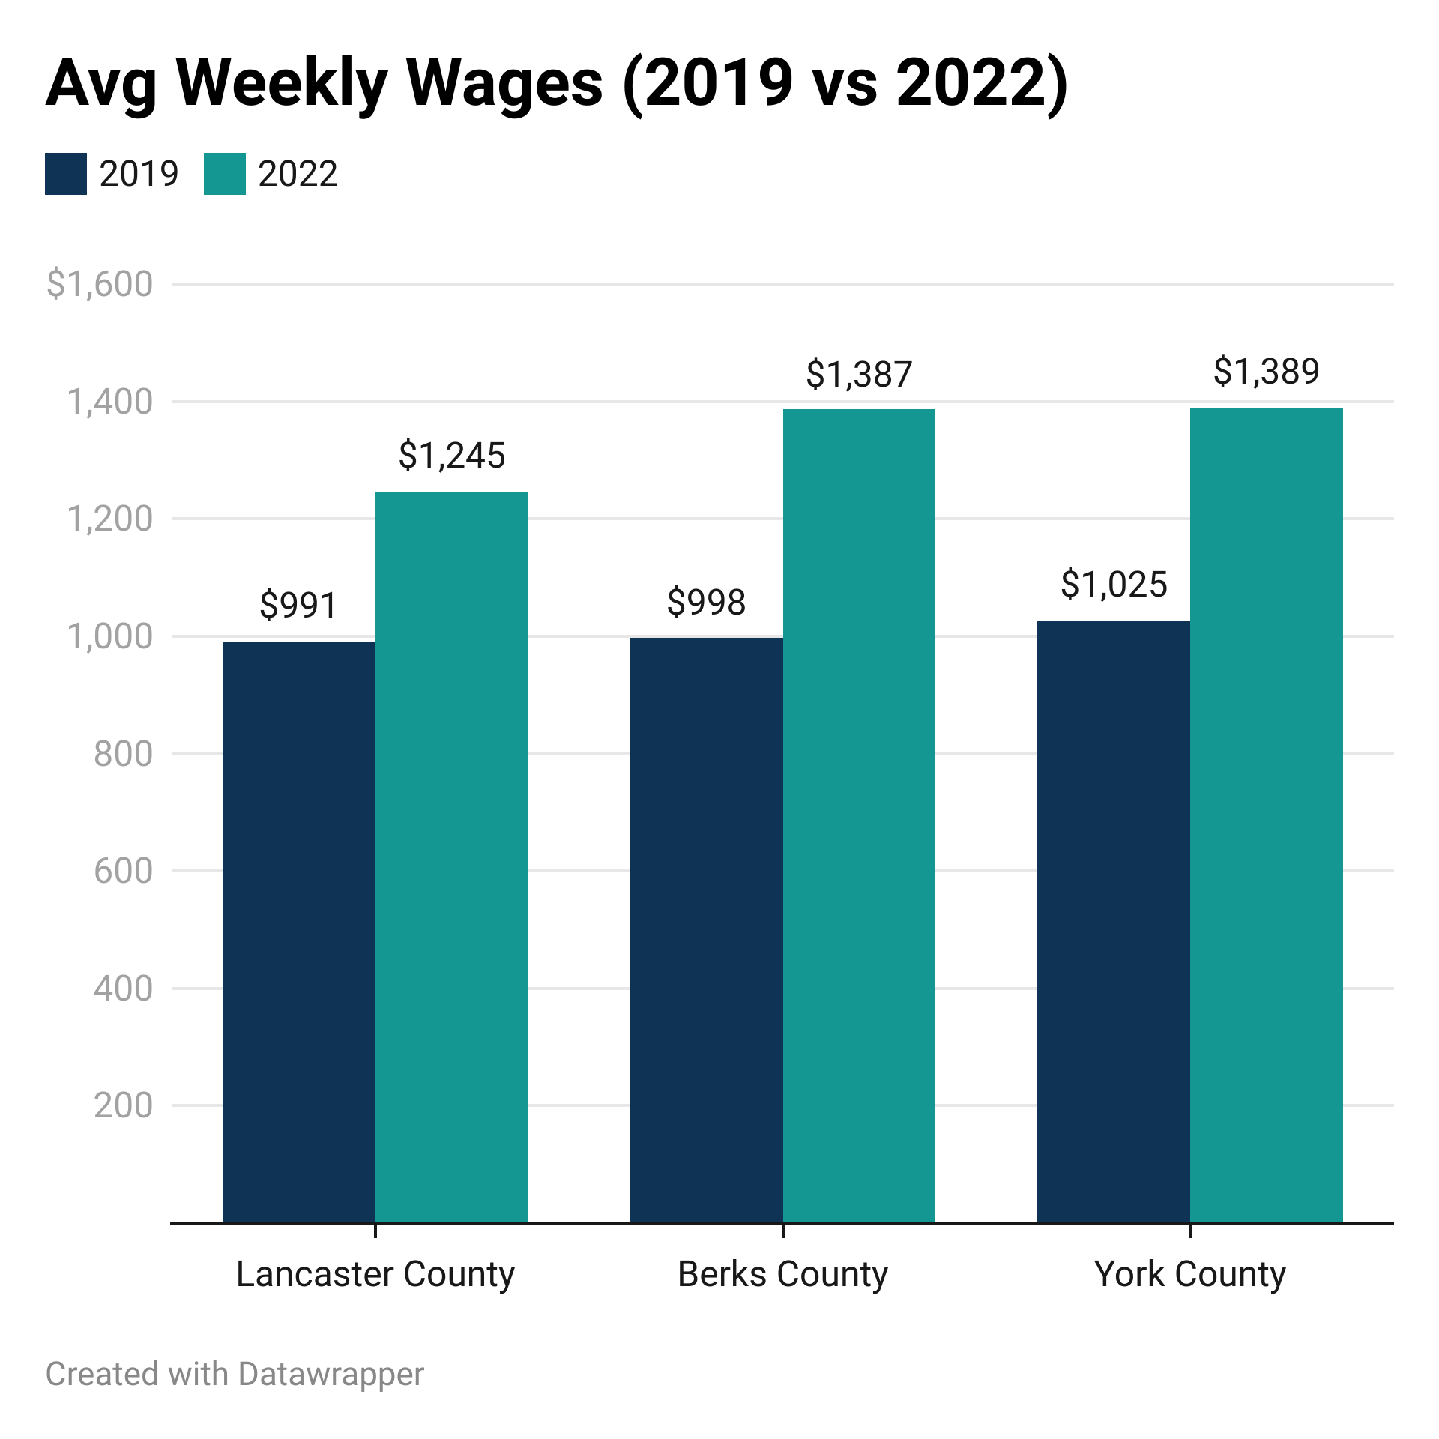
Regional Comparison of Key Sectors: Education & Health Services (Q3)
US Bureau of Labor Statistics, “Quarterly Census of Employment and Wages”; bls.gov/cew

Slide 16
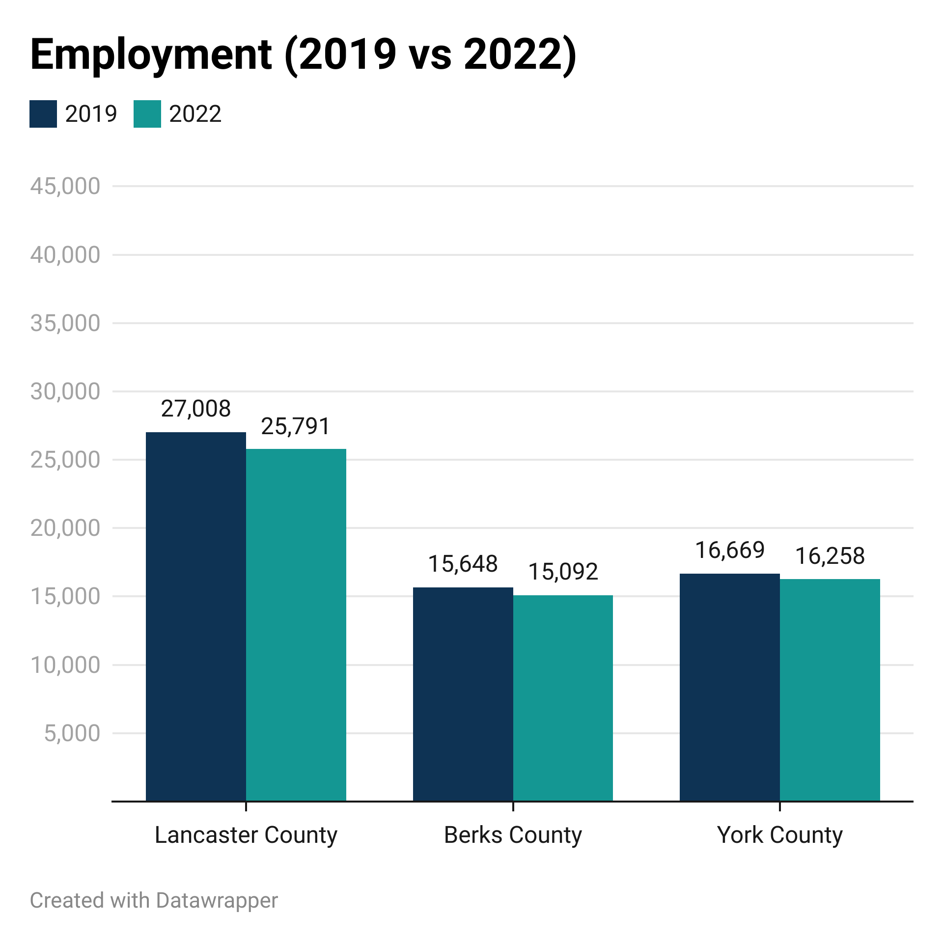
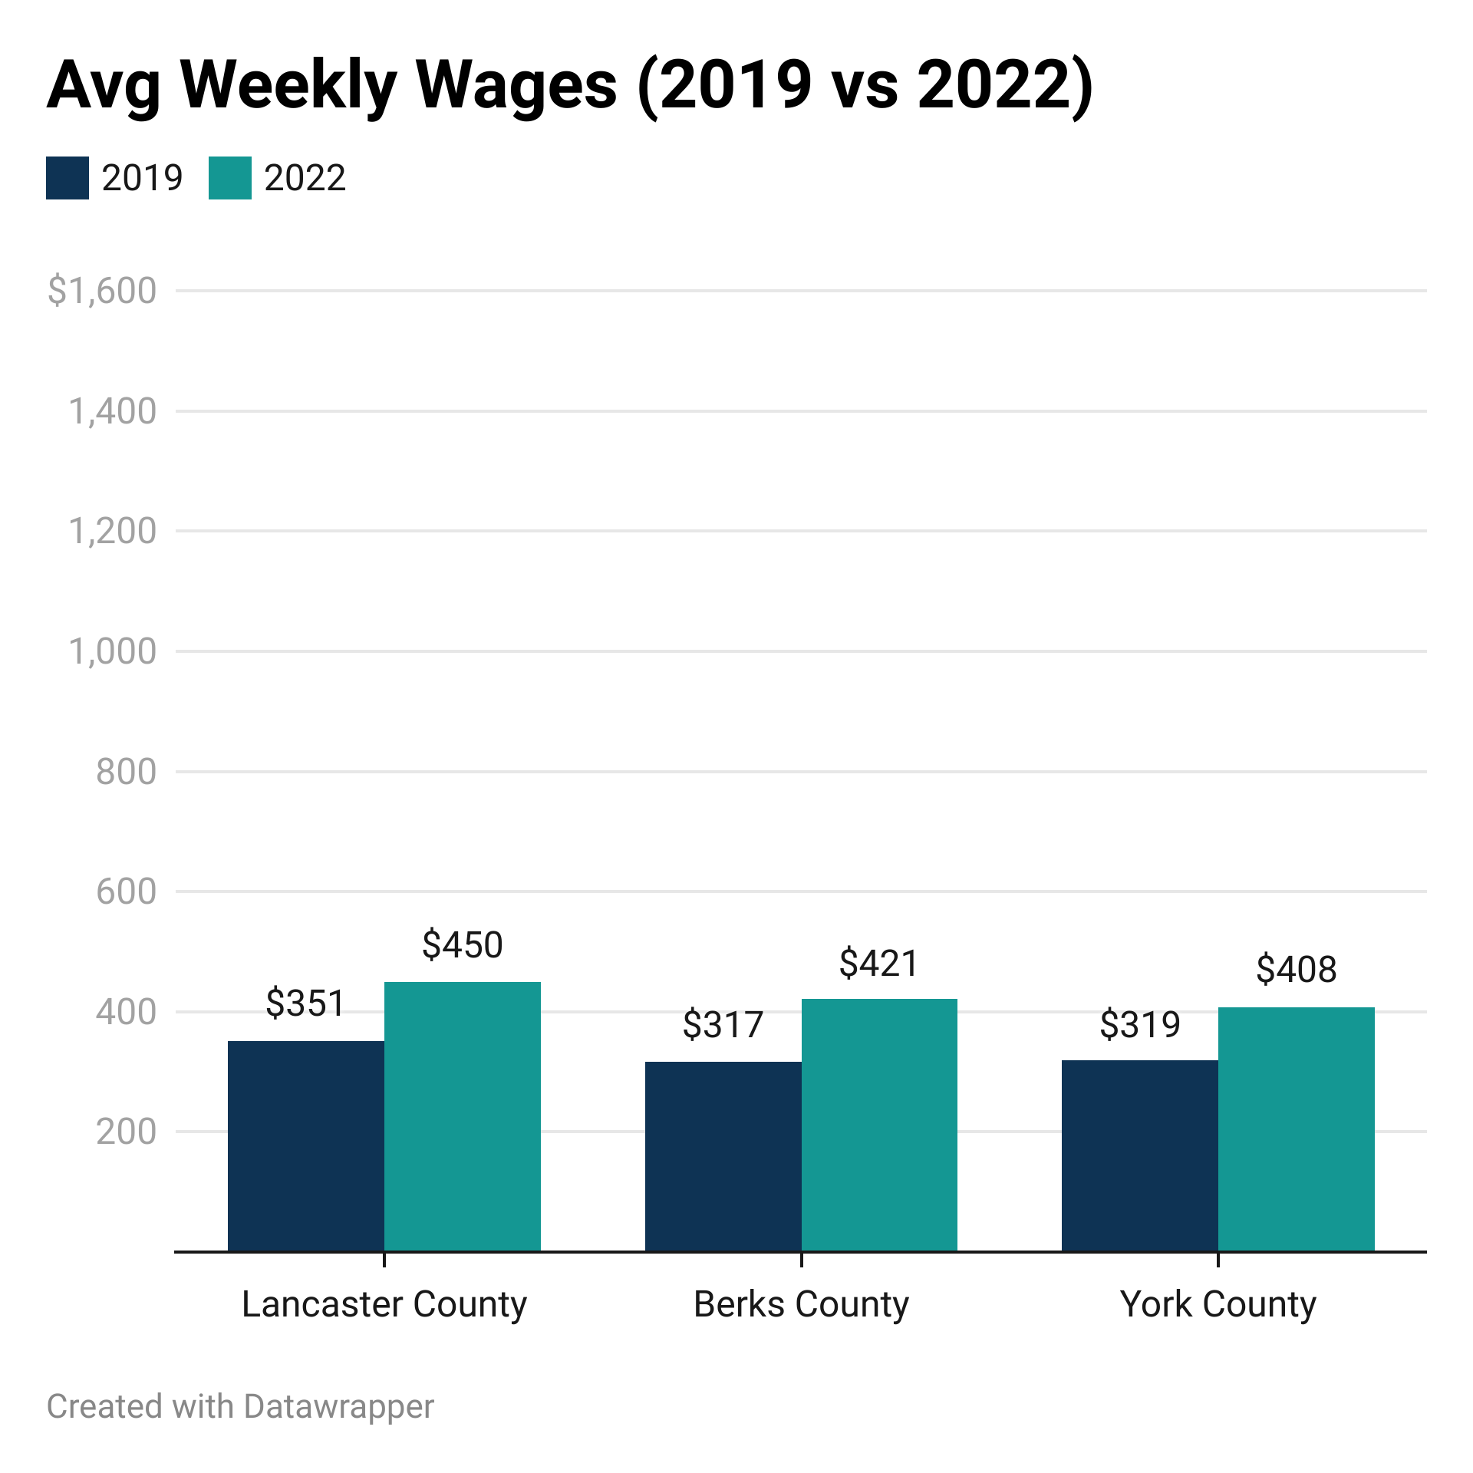
Regional Comparison of Key Sectors: Leisure & Hospitality (Q3)
US Bureau of Labor Statistics, “Quarterly Census of Employment and Wages”; bls.gov/cew

Slide 17
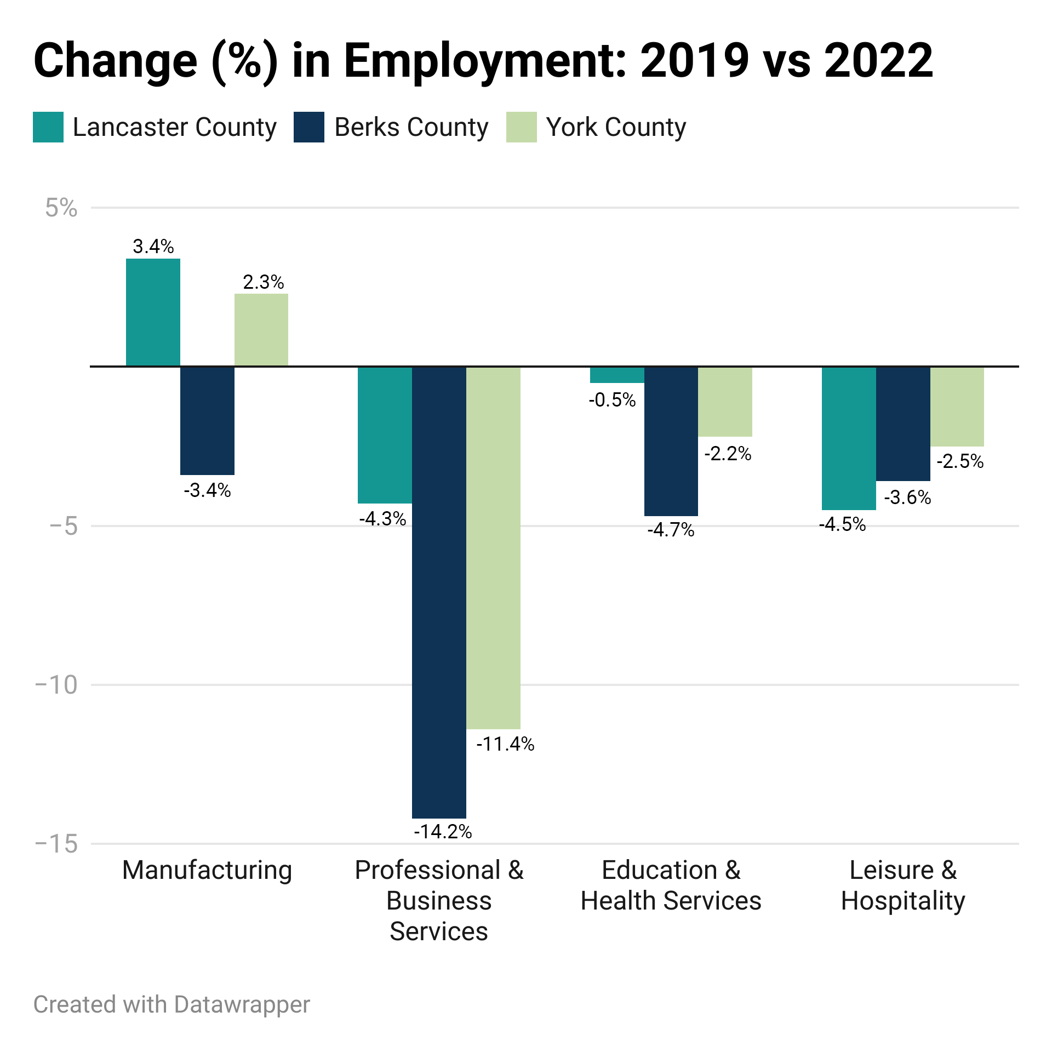
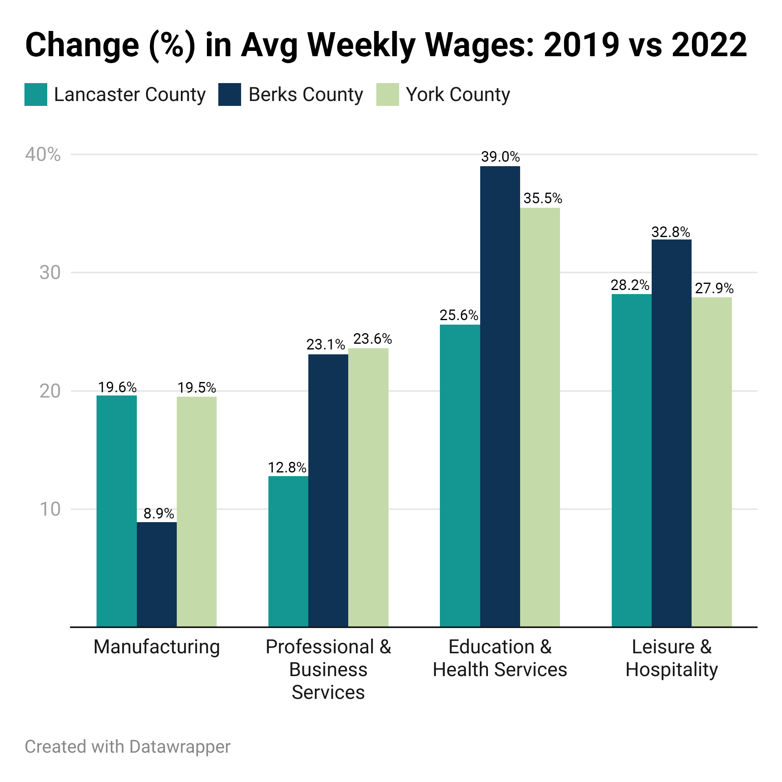
Regional Comparison: Employment & Wages (Q3)
US Bureau of Labor Statistics, “Quarterly Census of Employment and Wages”; bls.gov/cew
Notes:
Great example… at that time.. Business velocity still strong.. In general at or under 2019 levels…

Slide 18
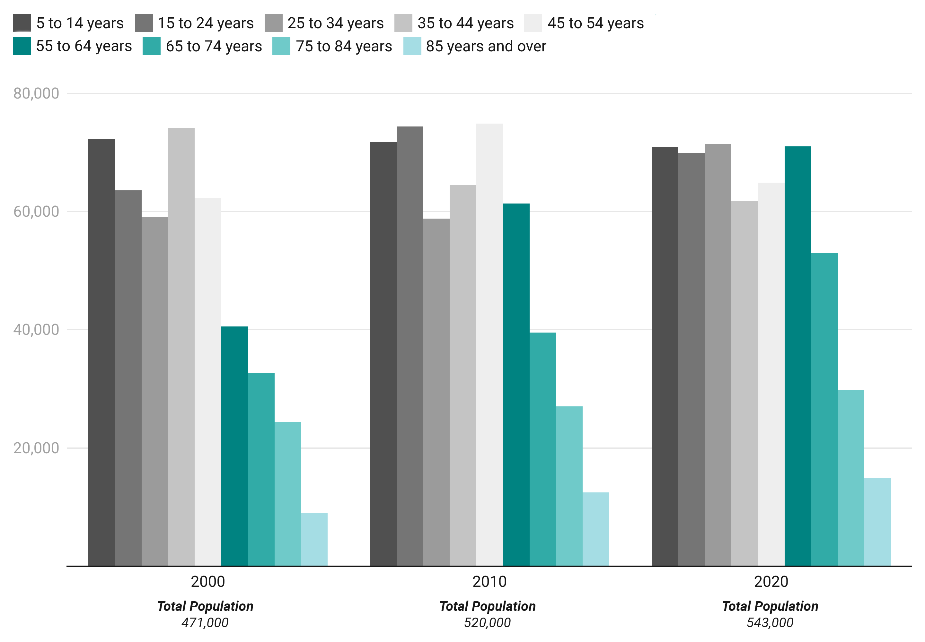
Lancaster County Population by Age Group (2000, 2010 & 2020)
Share of Lancaster’s population 55+ increased from 23% in 2000 to 31% in 2020.
25% of full-time workers in Lancaster County are 55+ years old.
U.S. Census Bureau, “2021 American Community Survey”; data.census.gov
Notes:
This slide is an outlier for the presentation as it doesn’t tie to pandemic conditions, however, we are including it to highlight this key issue. . .

Slide 19

Key Workforce Issues for 2023 and Beyond
40%
of our current workforce demand in Lancaster County is due to retirements.
The biggest skills gap projected are in Digital Literacy, specifically Microsoft Office. 77% of jobs will require skills like spreadsheets, word processing and office software.
94,457
Projected # of retirements in Lancaster County by 2030
1.5
current # job openings for every job seeker
More than half of projected retirements are in these 5 occupations:
Office and Admin Support
Transportation and Material Moving
Sales
Production Occupations
Food Prep and Serving Related
Education level required for current job openings:
23% High School Diploma
58% certifications or on-the-job experience
<1% Associates Degree
11% Bachelors Degree
<1% Masters/Doctoral
Notes:
2.4 million additional Americans retired in the first 18 months of the pandemic (almost ½ of the 4.2 million who left the labor force). An estimated 1.5 million retirees have re-entered the US Labor Market. This reflects the rebound we see, but what’s on the horizon is continued retirements forecasted at an alarming rate.

Slide 20




Workforce Solutions
Financial Support
Embrace Technology & Innovation
Collaboration & Partnership
Retention
Notes:
We are here to help!

Slide 21
Workforce Solutions
Financial Support
Paid Internships for Youth – 100% funded by CareerLink®
On-the-Job Training – up to 75% reimbursement to employer during training period, max $10,000
Upskilling Current Workforce– 50-90% reimbursement of training costs
Apprenticeship – 50% of the cost of technical training (can + OJT funding)

Slide 22

Workforce Solutions
Collaboration and Partnership
www.careerreadylancaster.com

Slide 23
CENTER FOR REGIONAL ANALYSIS
AT
ECONOMIC DEVELOPMENT COMPANY
OF LANCASTER COUNTY
115 EAST KING STREET, LANCASTER, PA 17602
EDCLANCASTER.COM/CENTER-FOR-REGIONAL-ANALYSIS-2
FOR MORE INFORMATION:
Rae Ann Miller, Data Analyst
ramiller@edclancaster.com

